Slide 1
A’ μμ
500-600 cm

Slide 2
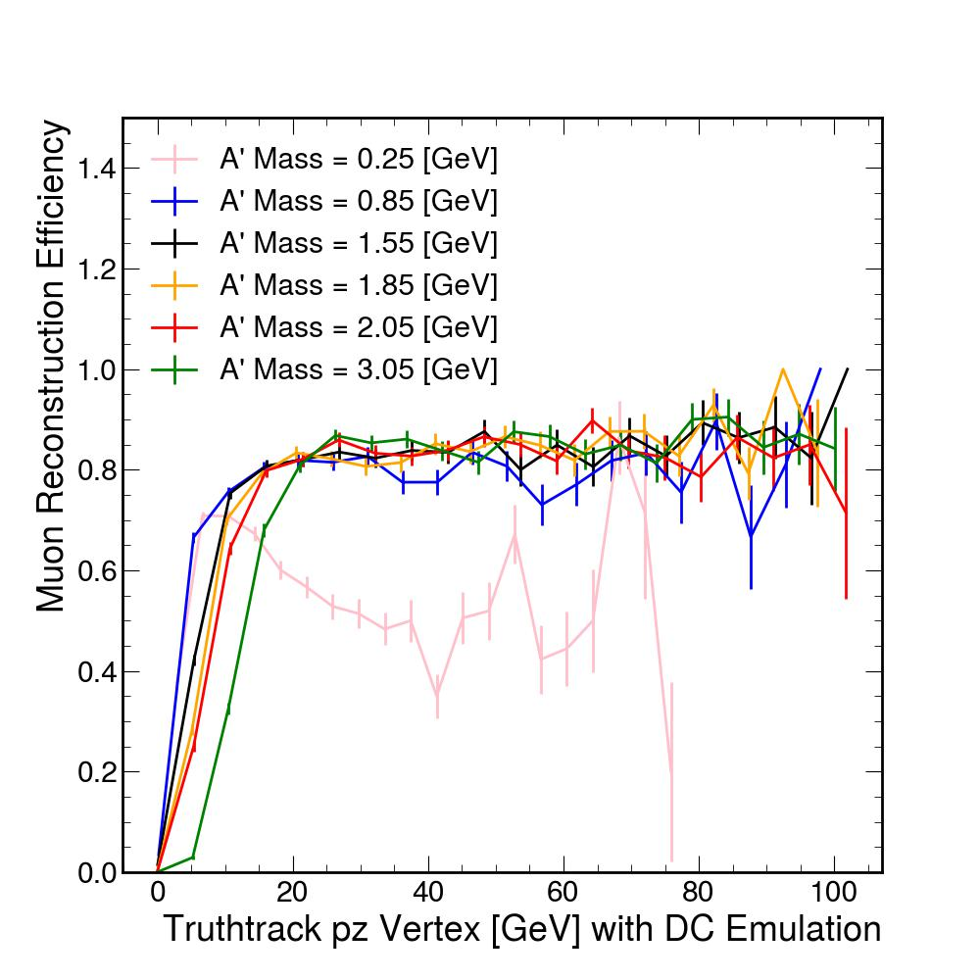
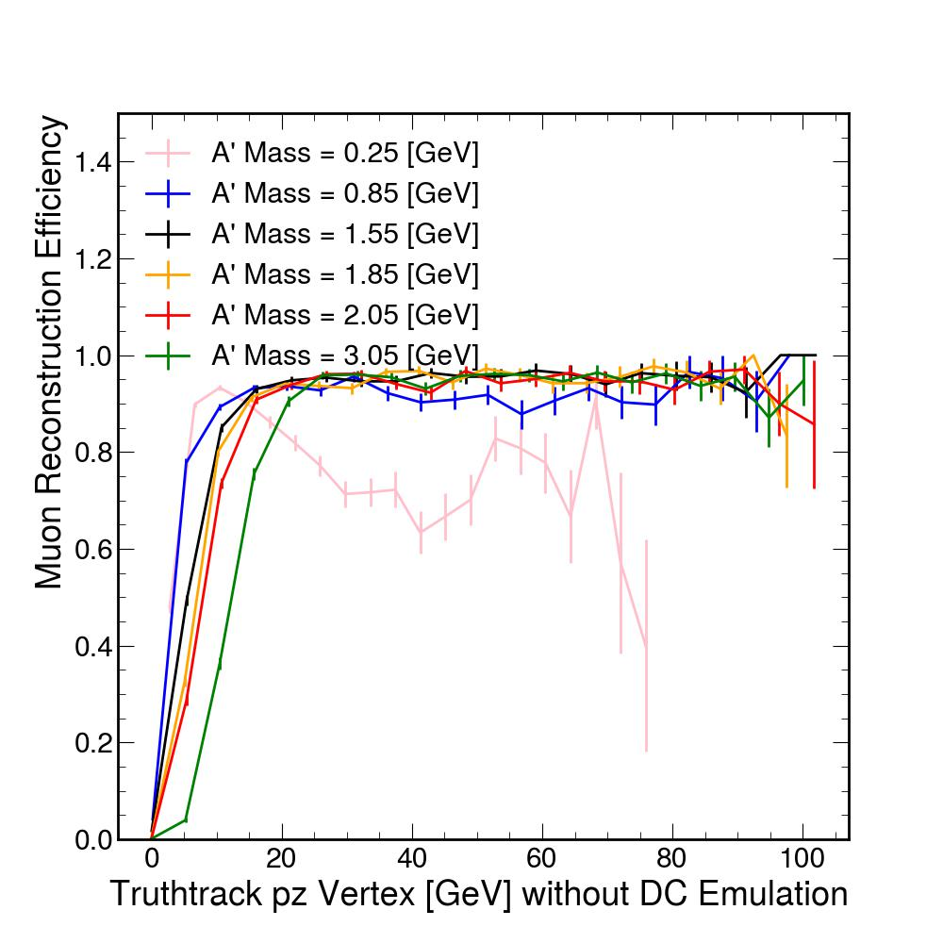
Muon Reconstruction Efficiency

Slide 3
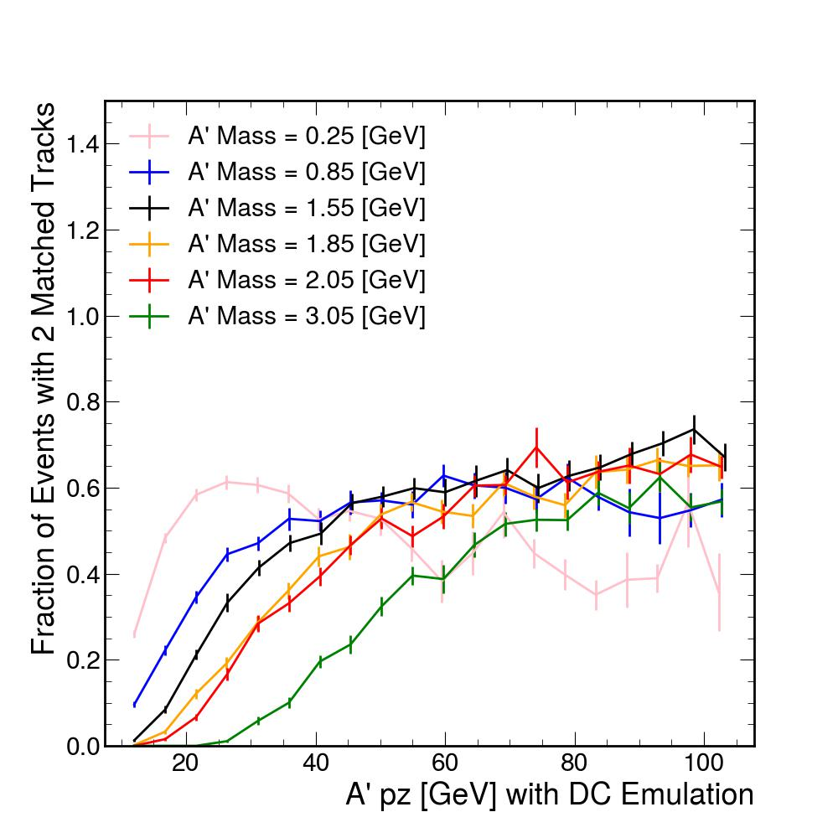
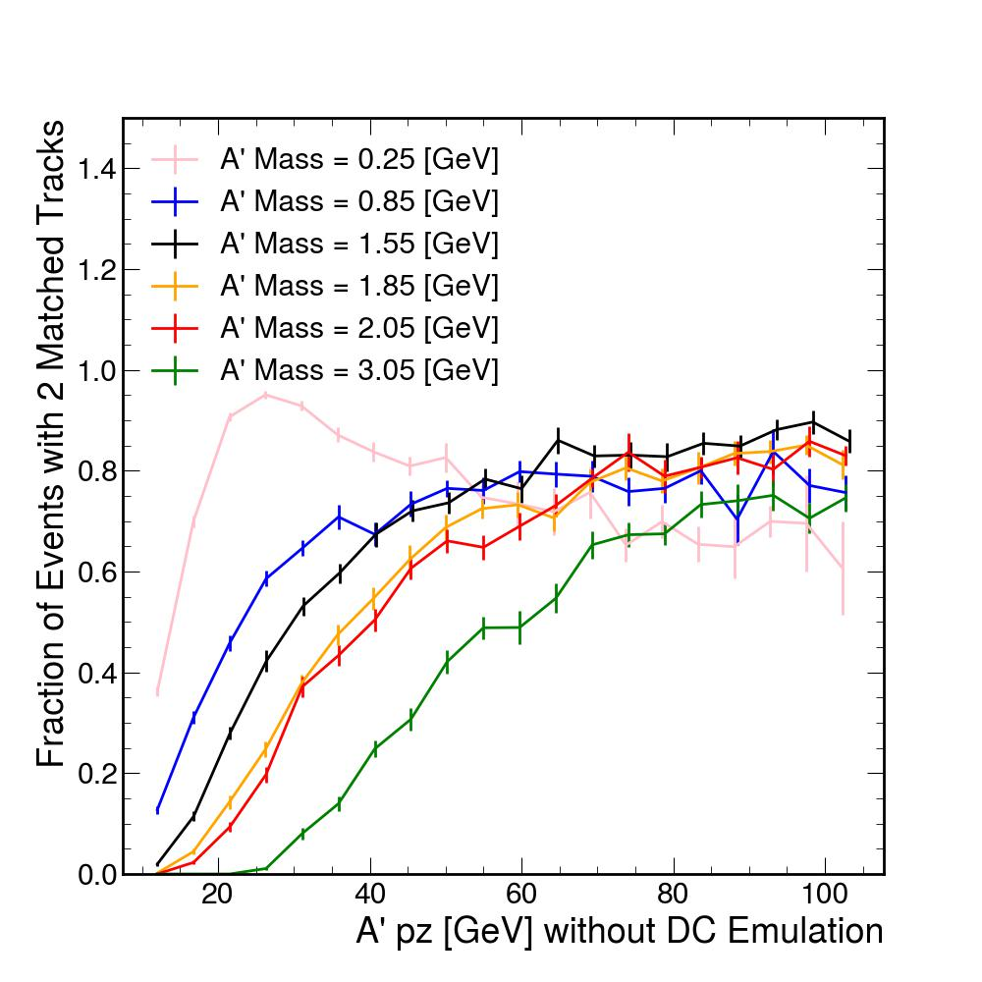
Fraction of Events with 2 Matched Tracks

Slide 4
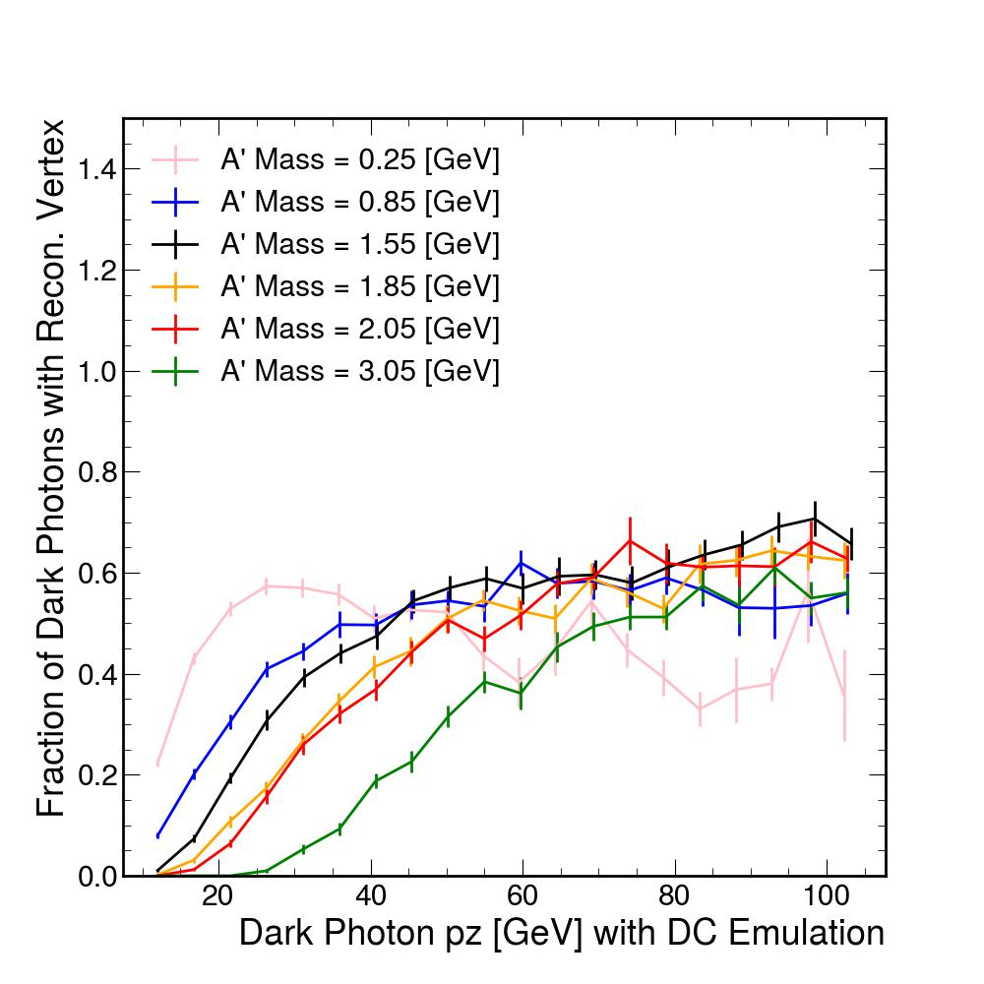
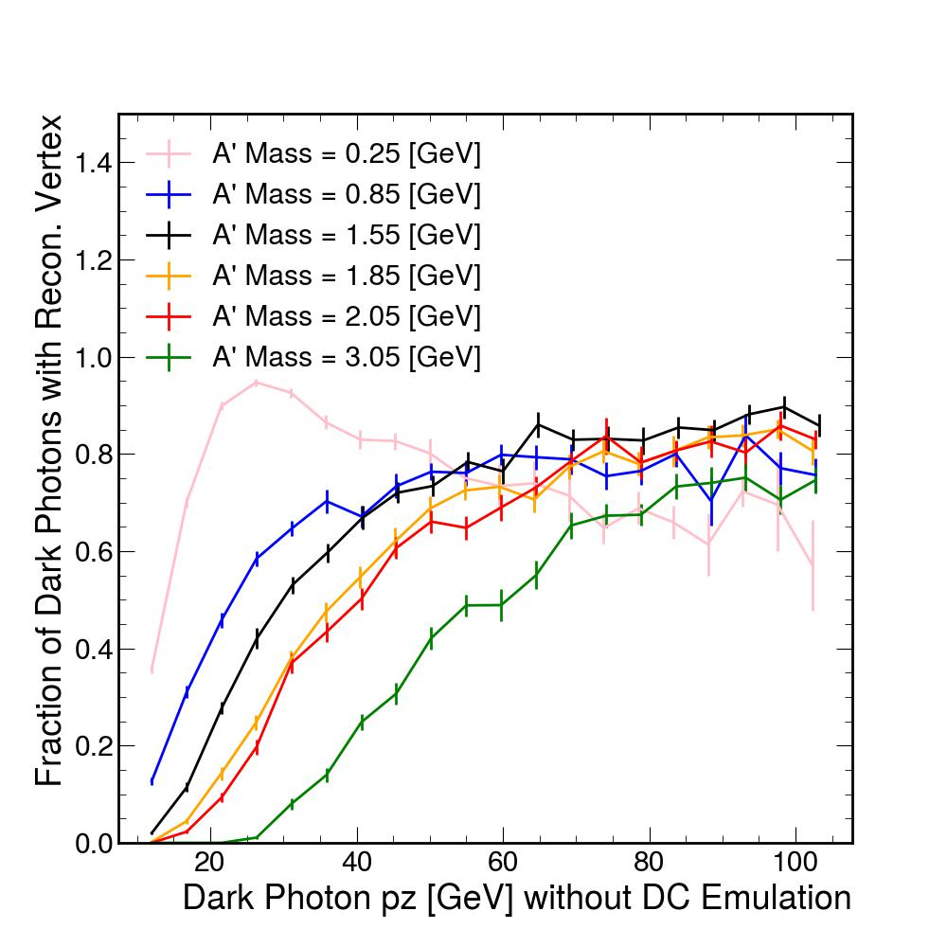
Fraction of Dark Photons with Reconstructed Vertex

Slide 5
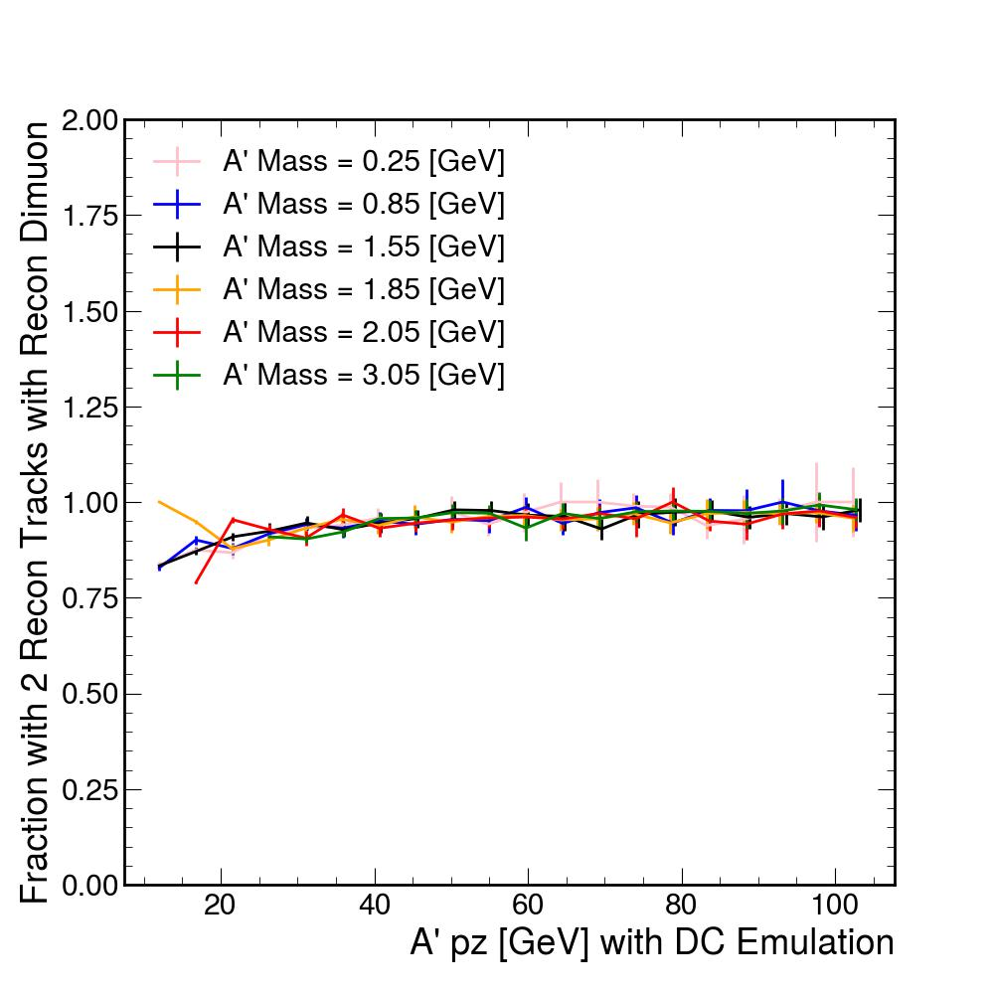
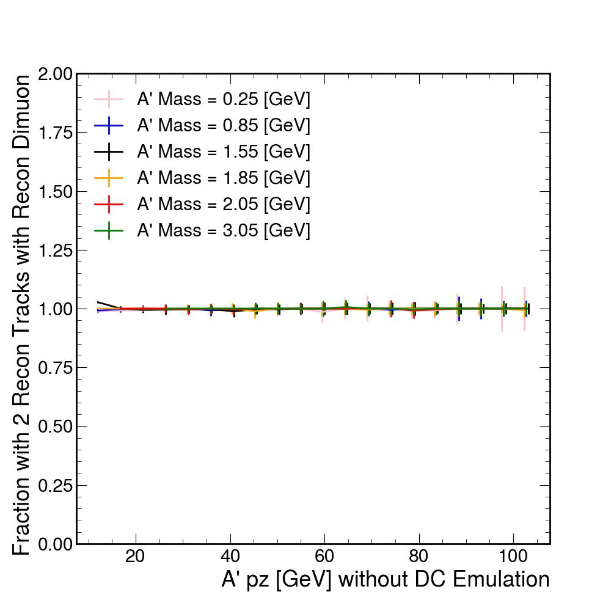
Fraction with 2 Reconstructed Tracks with Recon. Dimuon

Slide 6
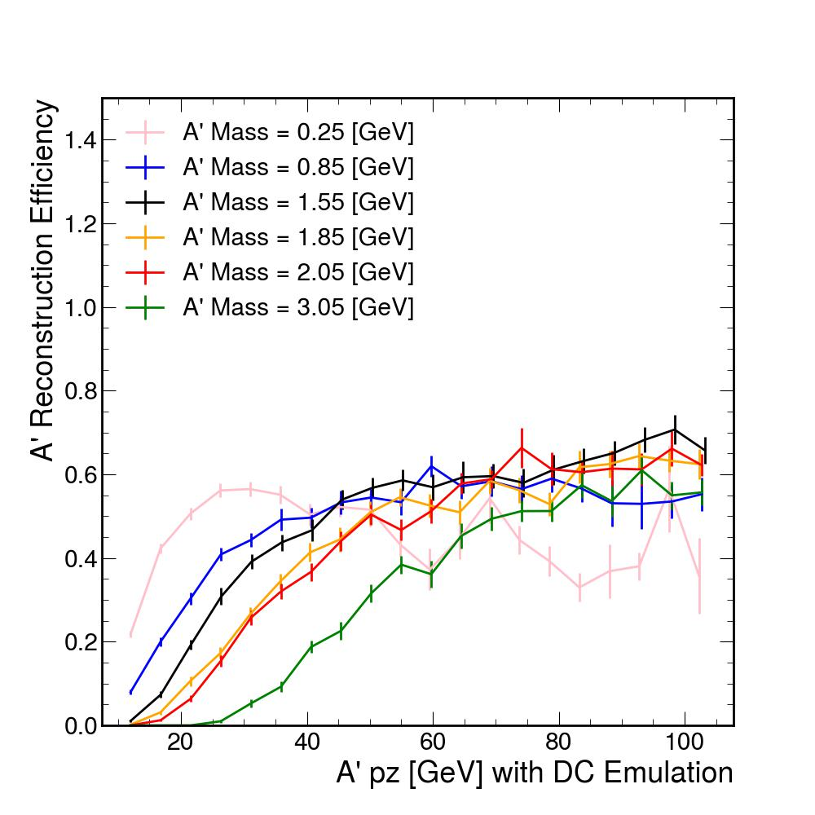
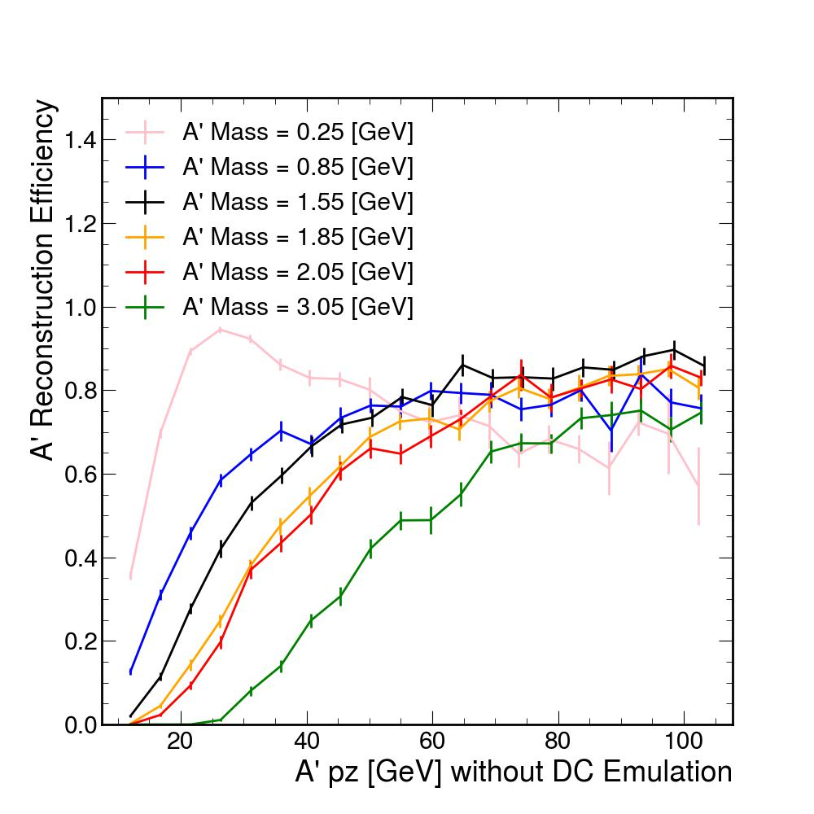
A’ Reconstruction Efficiency

Slide 7
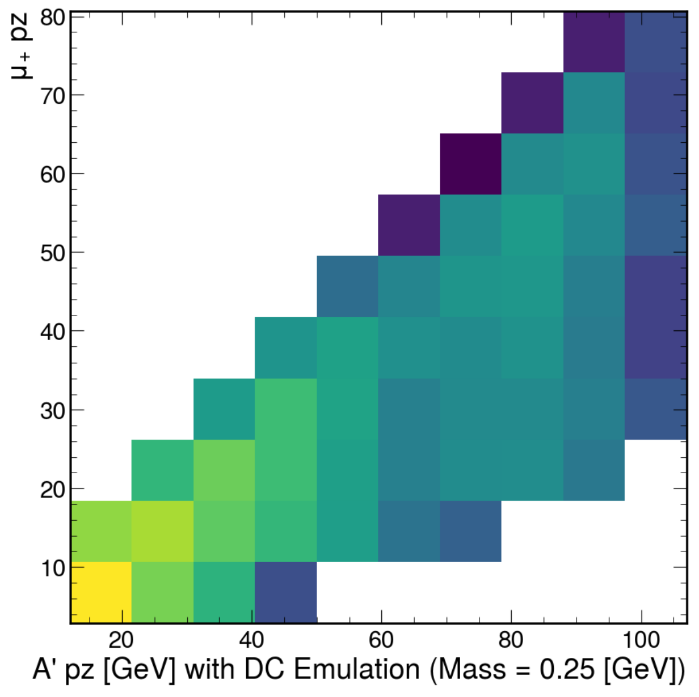
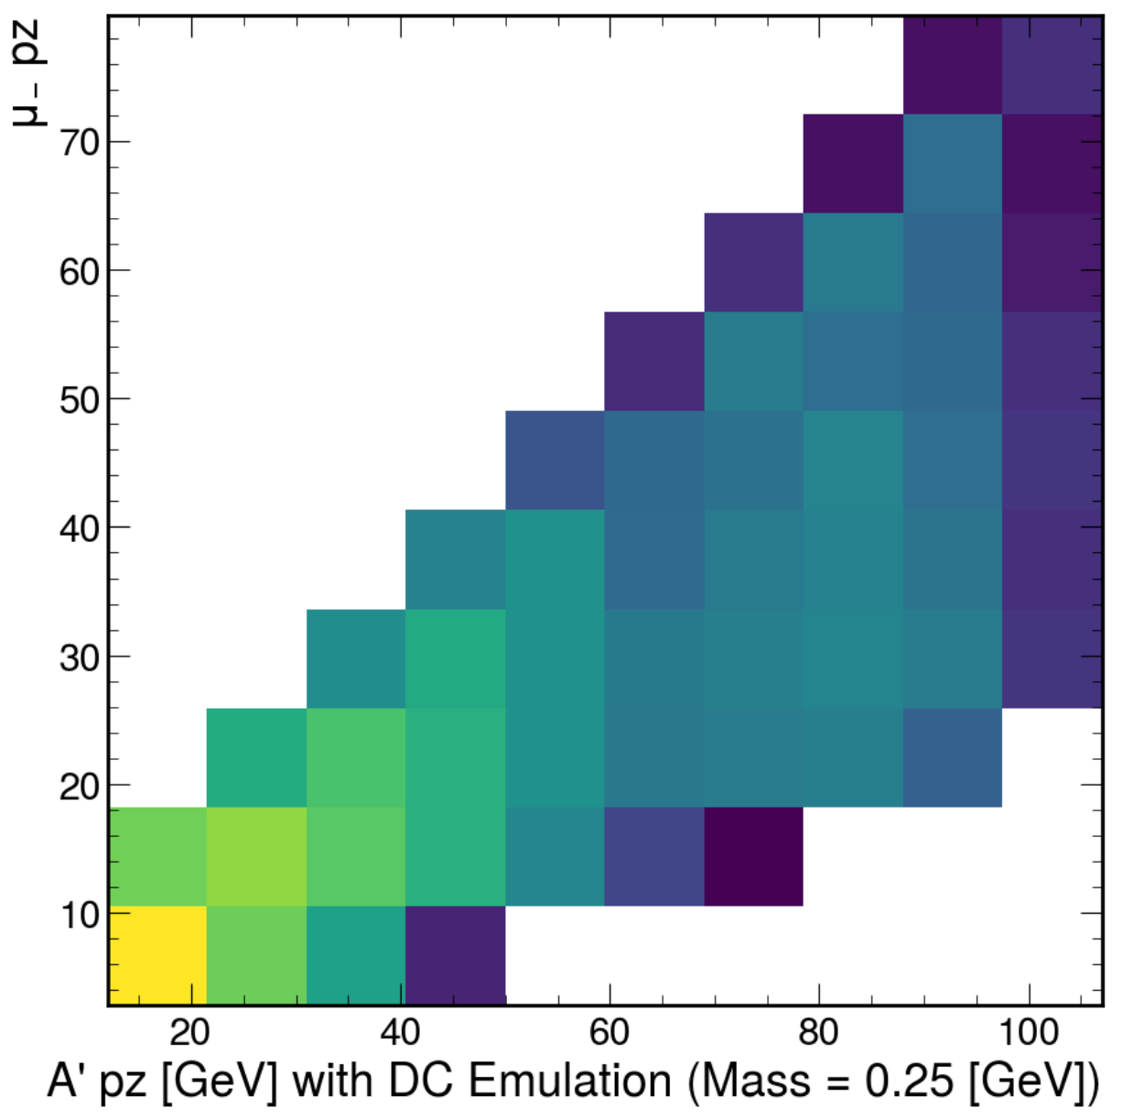
μ+/μ- pz (A’ mass = 0.25 GeV)

Slide 8
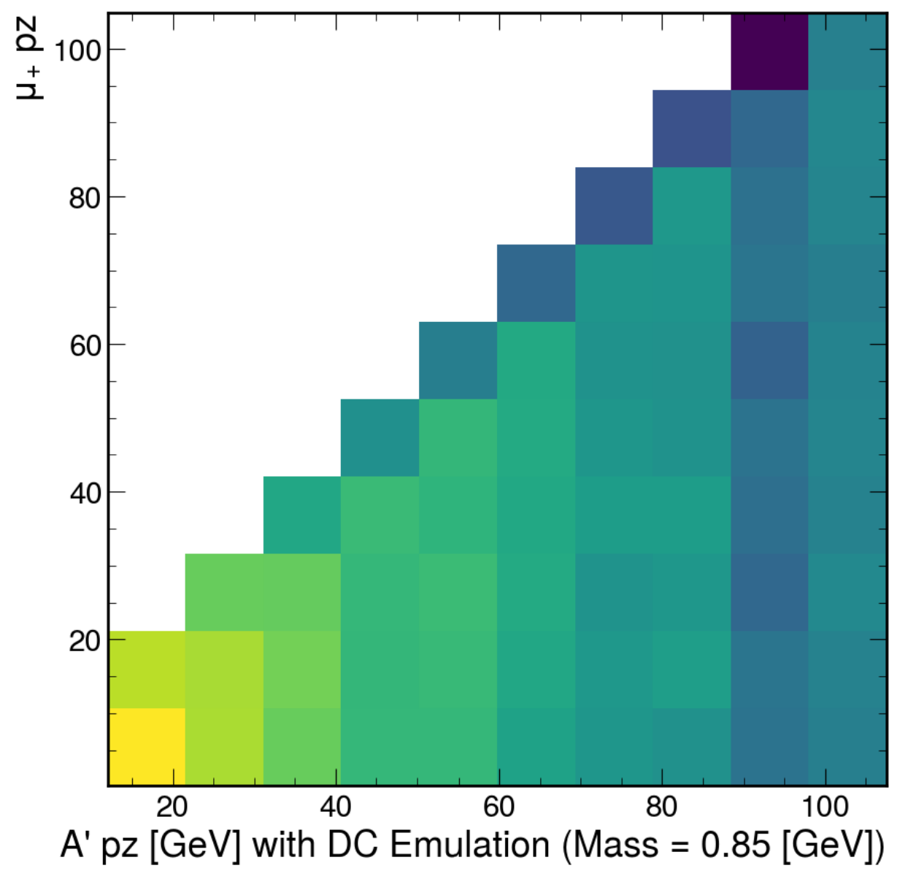
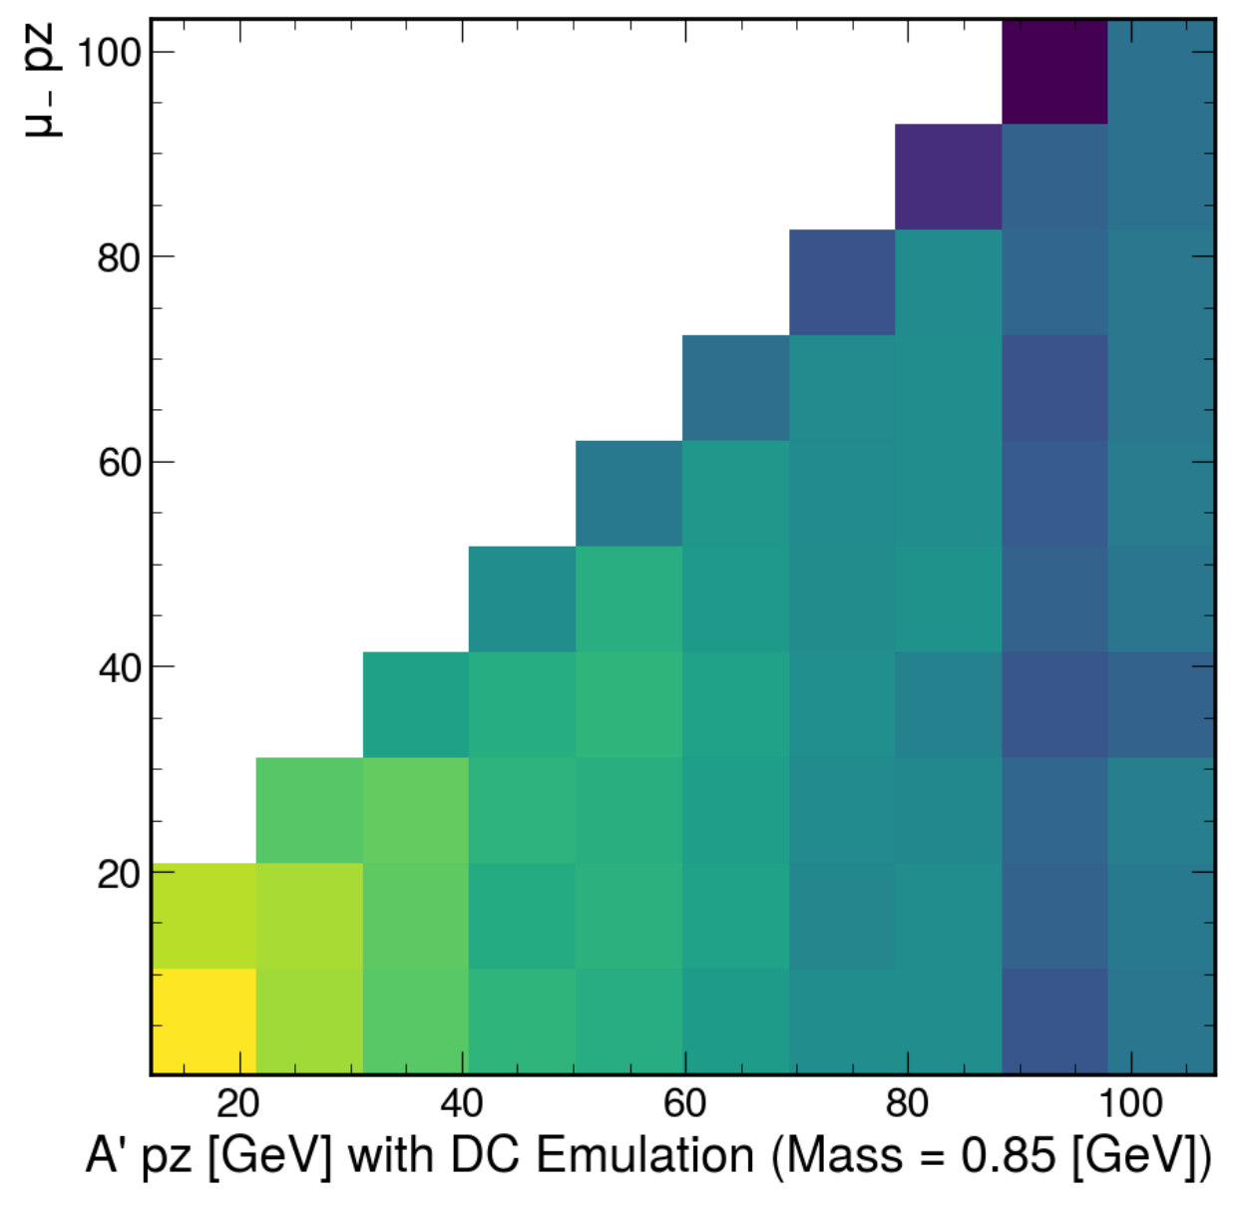
μ+/μ- pz (A’ mass = 0.85 GeV)

Slide 9
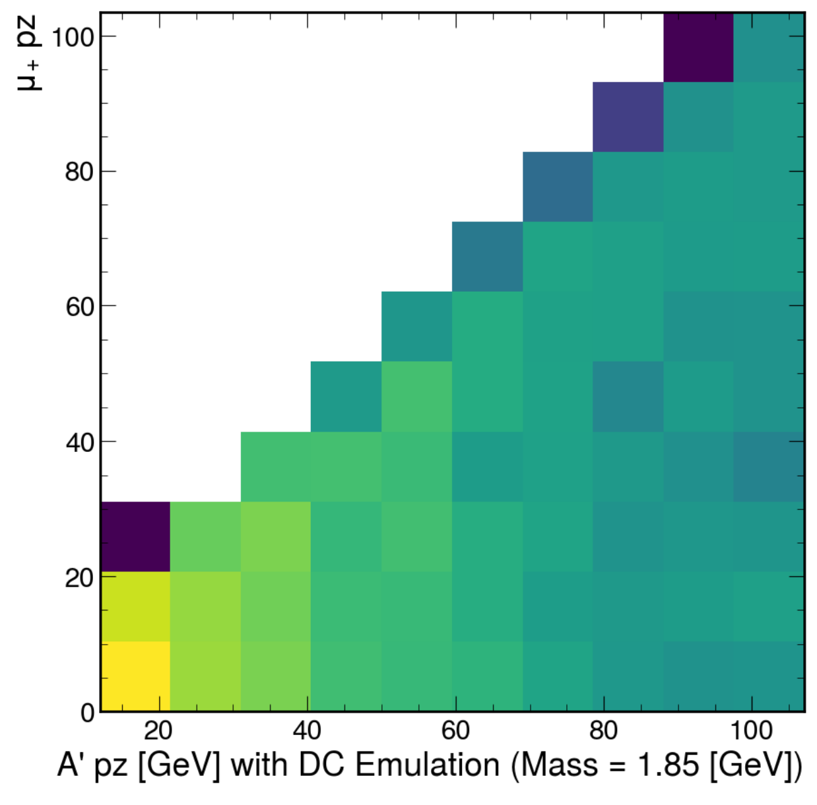
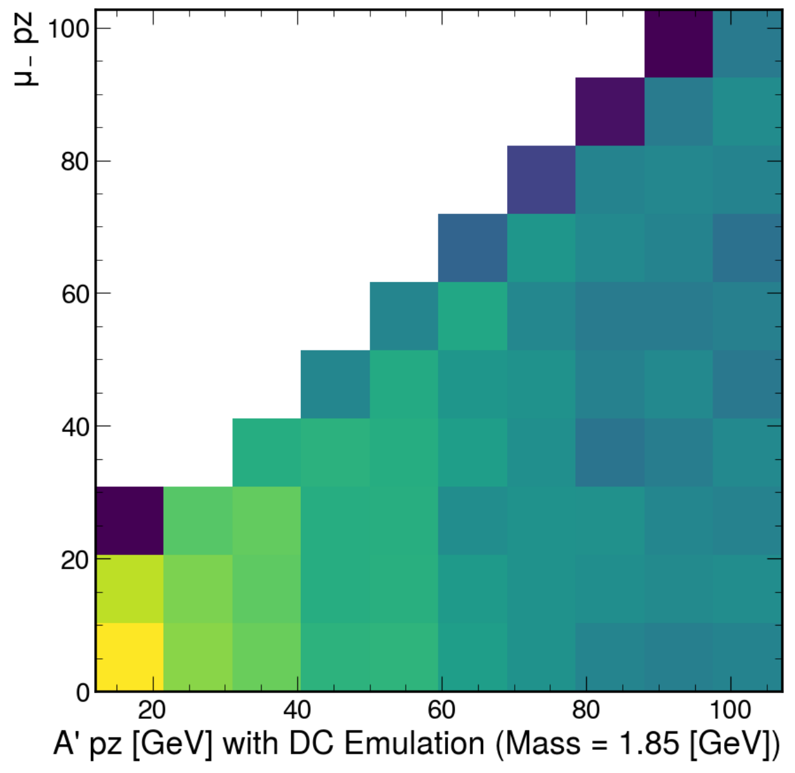
μ+/μ- pz (A’ mass = 1.85 GeV)

Slide 10
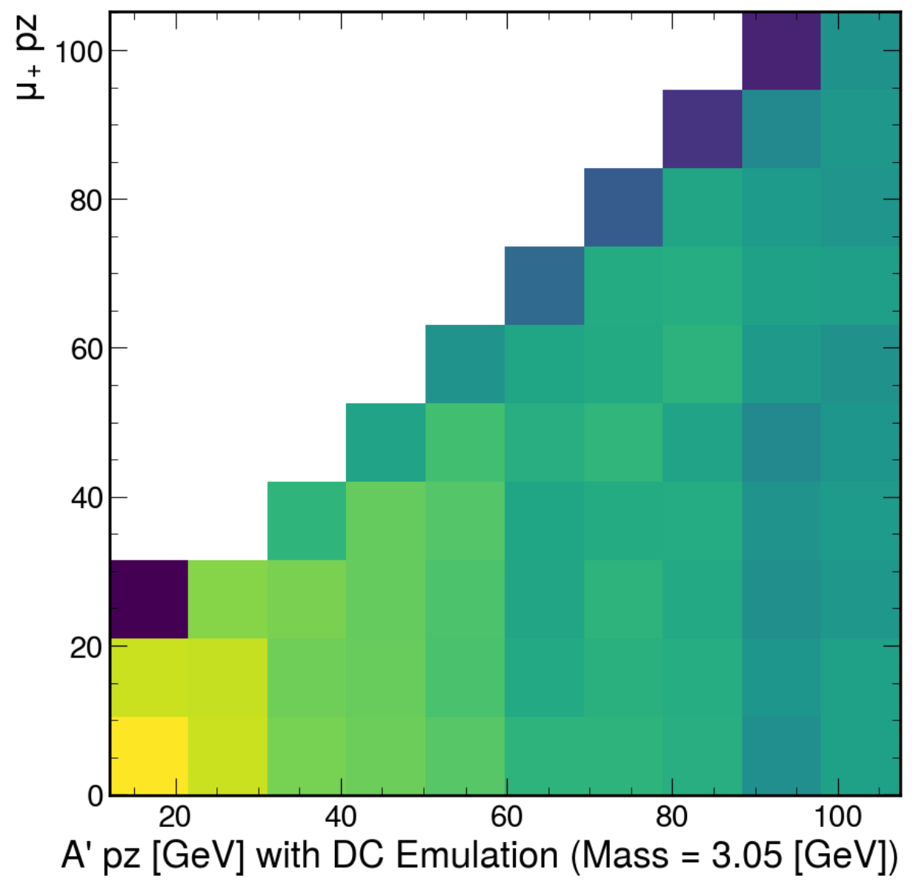
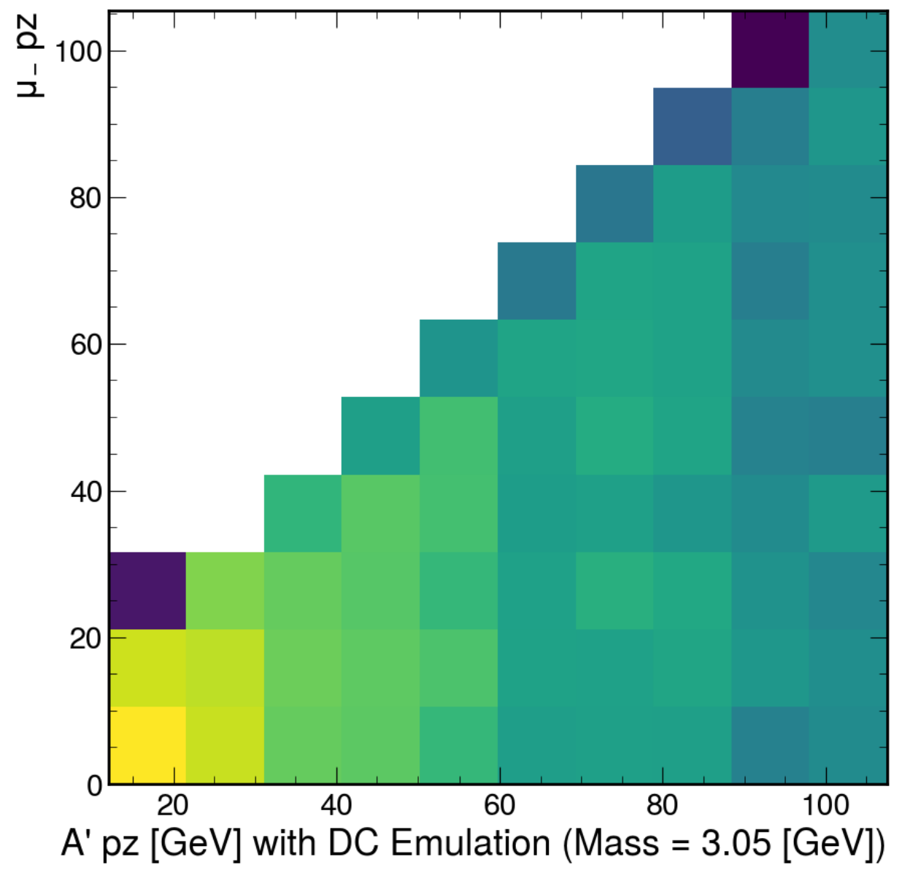
μ+/μ- pz (A’ mass = 3.05 GeV)

Slide 11
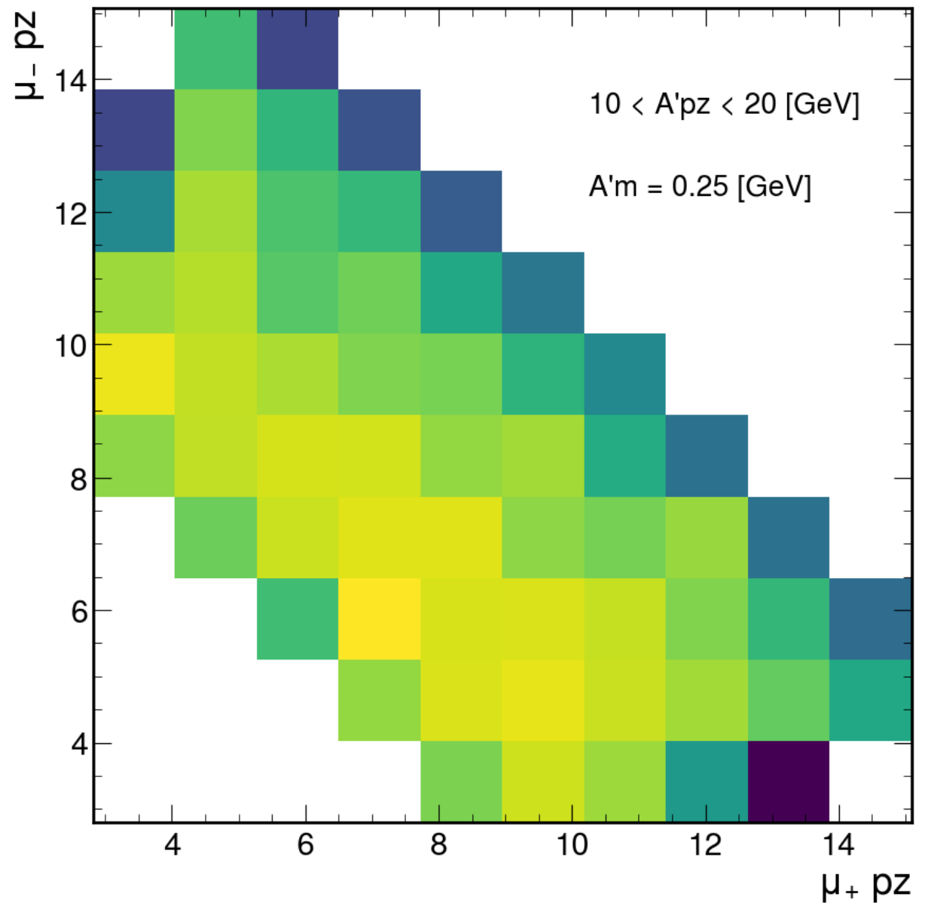
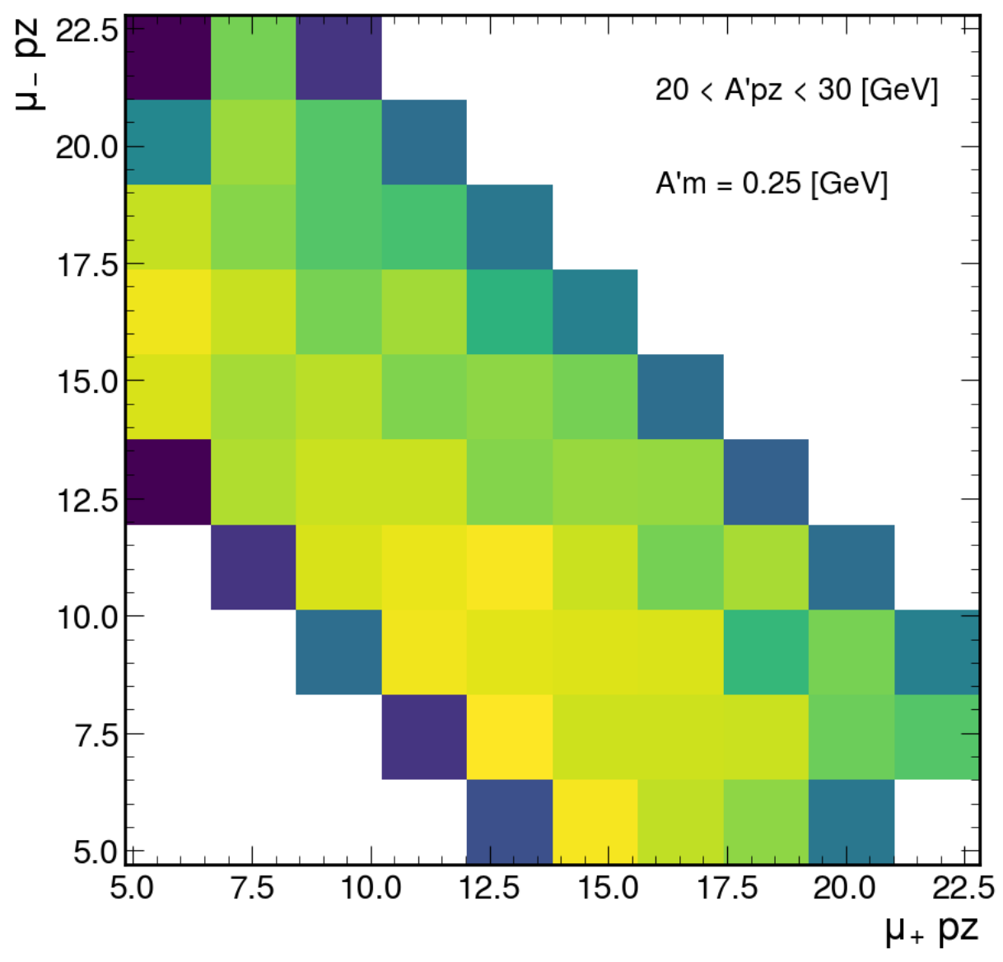
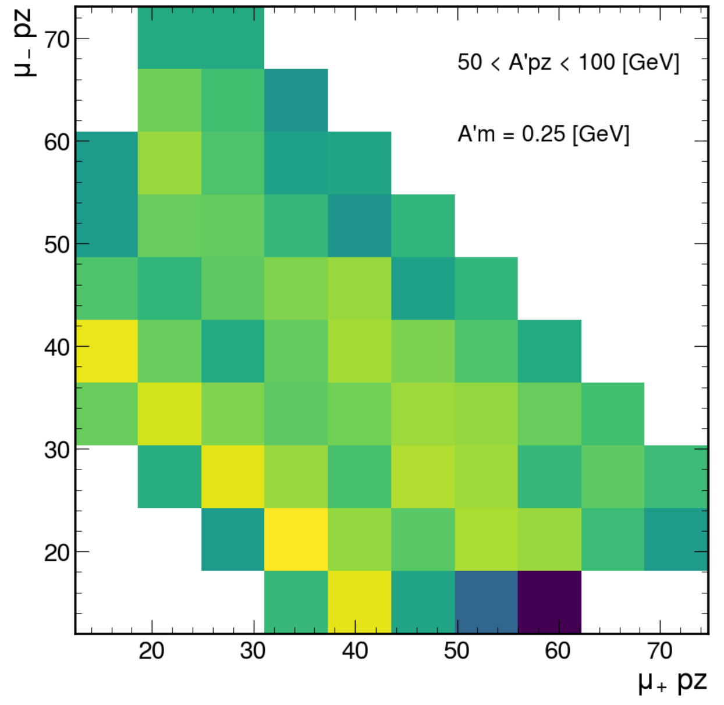
μ+ versus μ- pz, A’ mass = 0.25 GeV

Slide 12
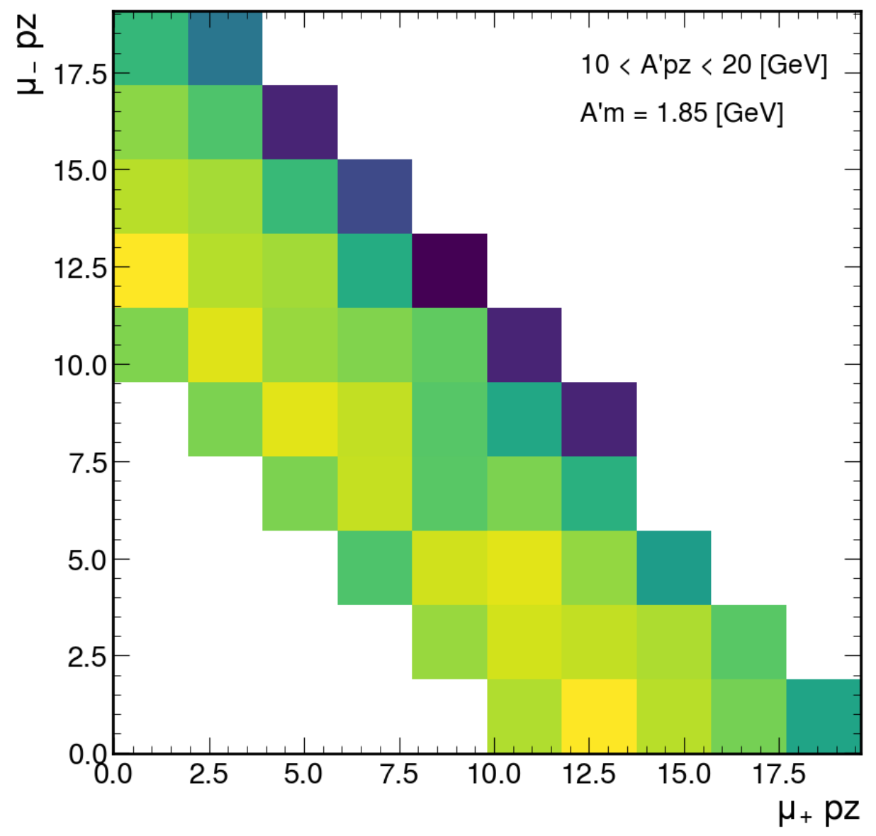
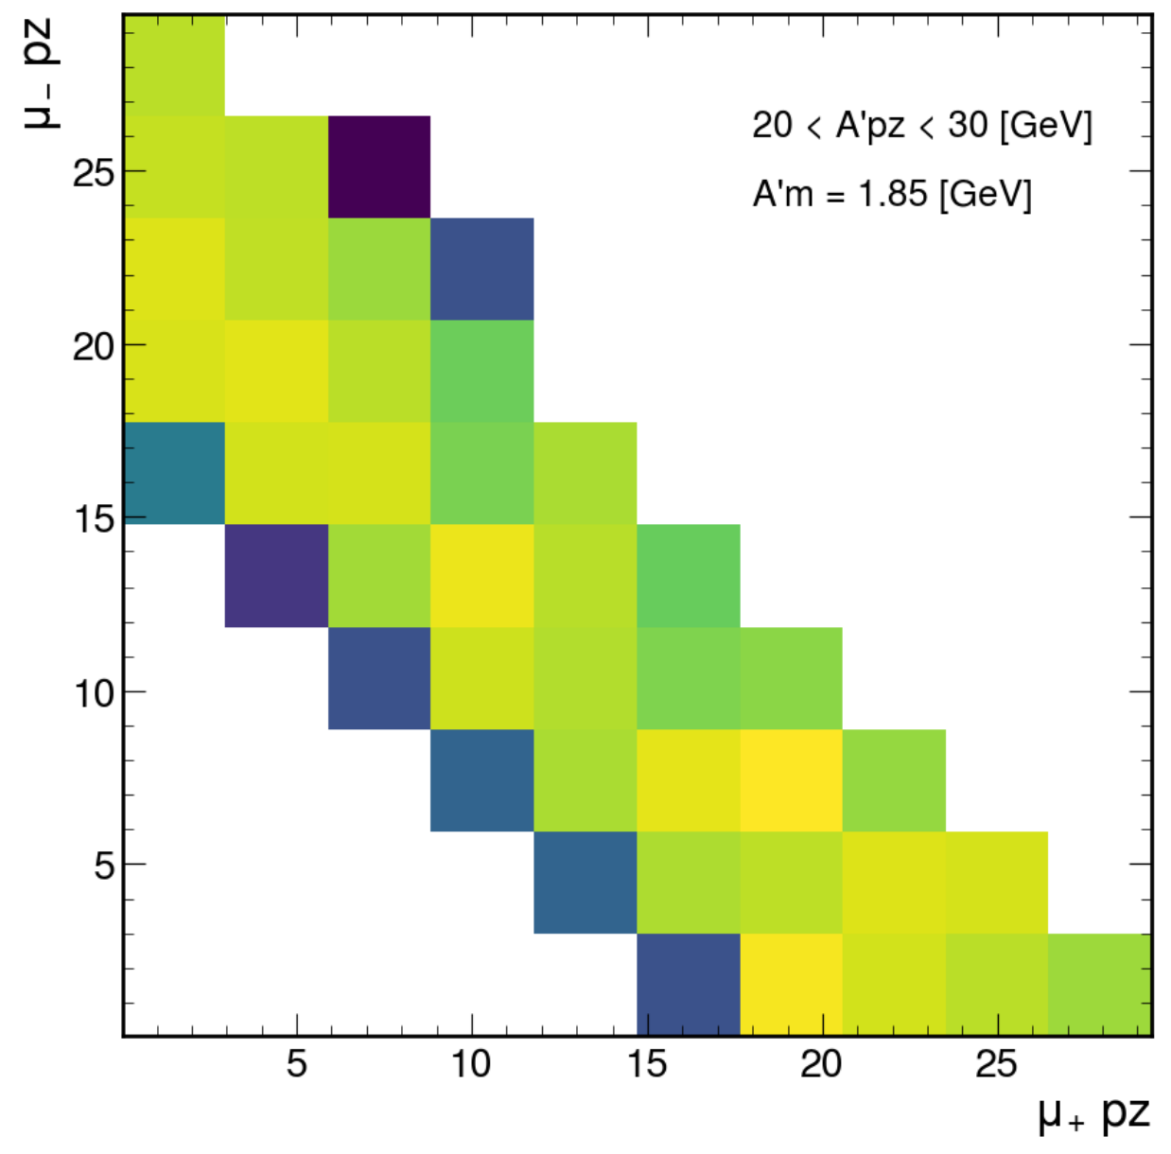
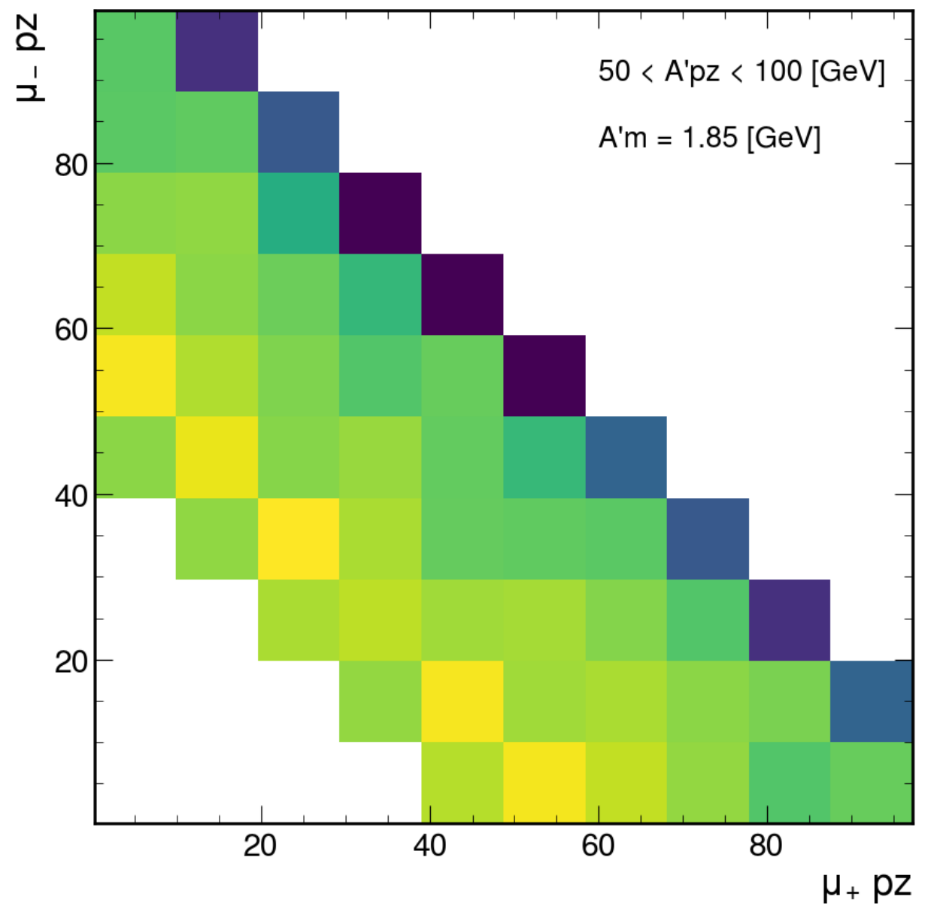
μ+ versus μ- pz, A’ mass = 1.85 GeV

Slide 13
A’ ee
500-600 cm

Slide 14
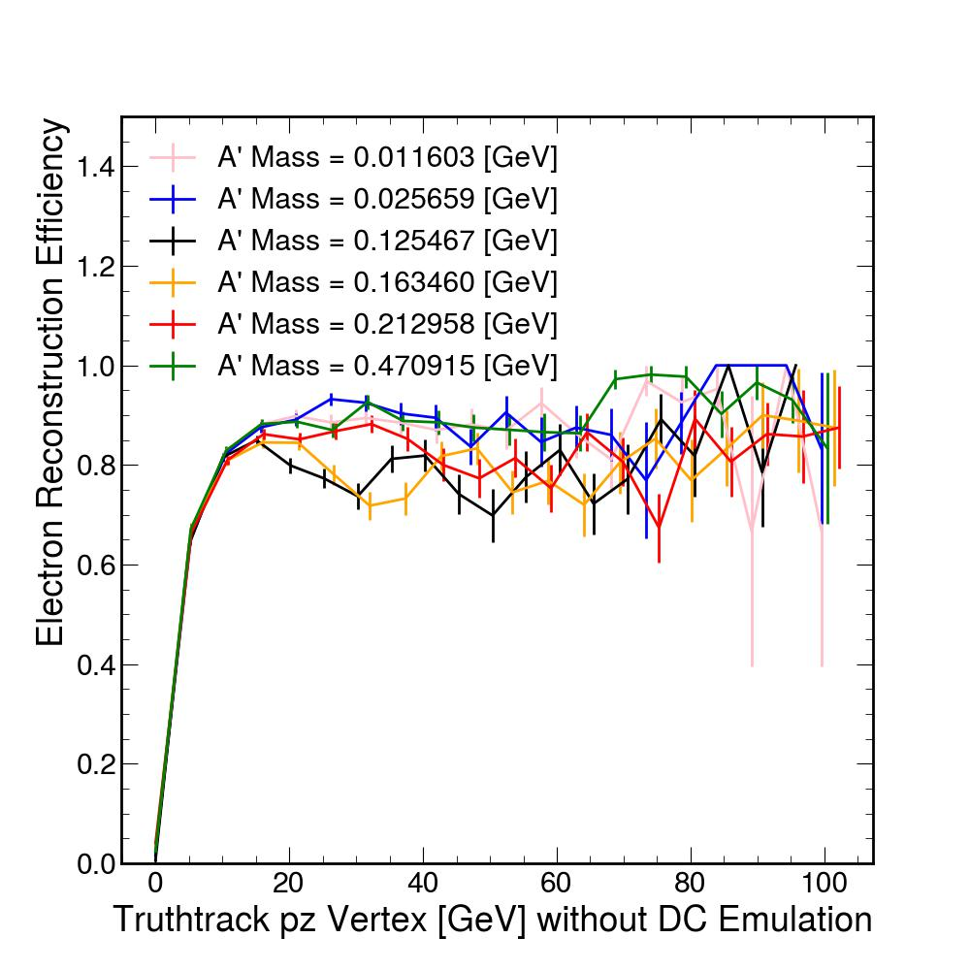
Electron Reconstruction Efficiency

Slide 15
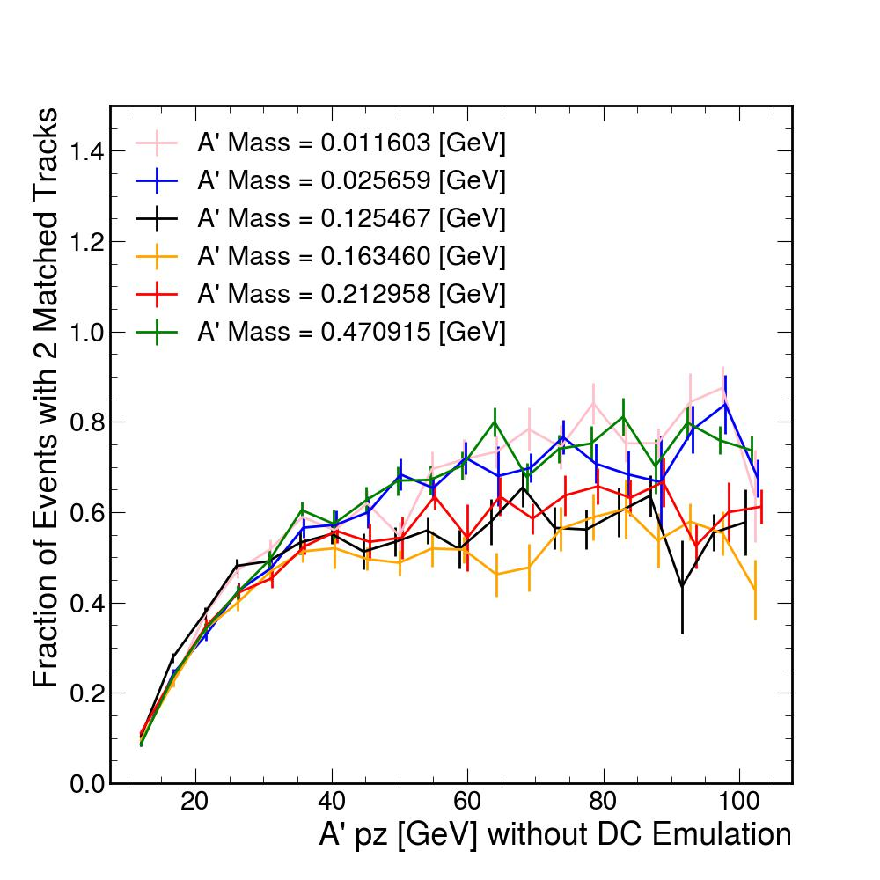
Fraction of Events with 2 Matched Tracks

Slide 16
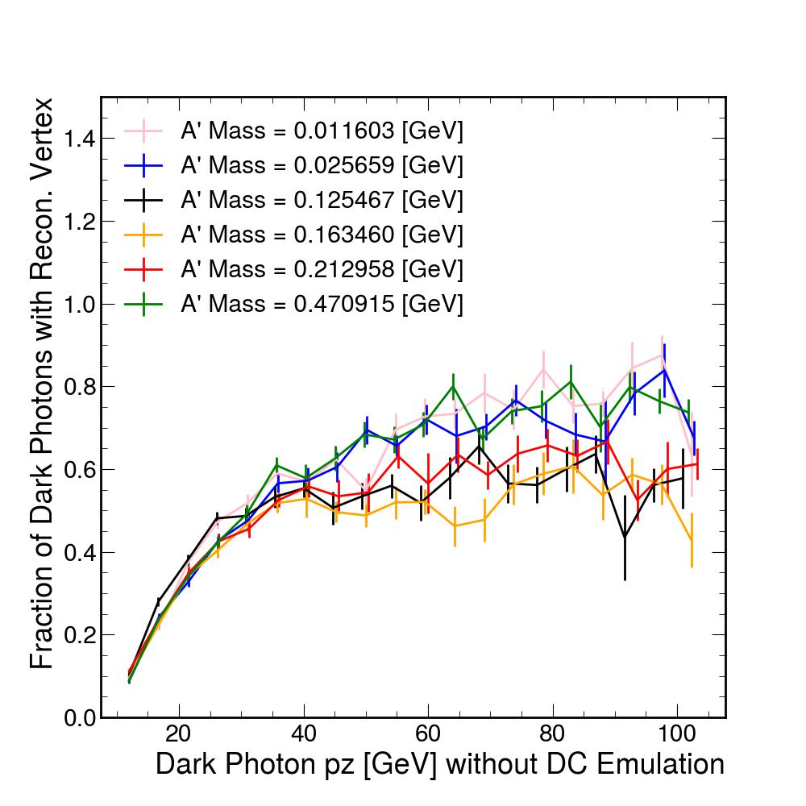
Fraction of Dark Photons with Reconstructed Vertex

Slide 17
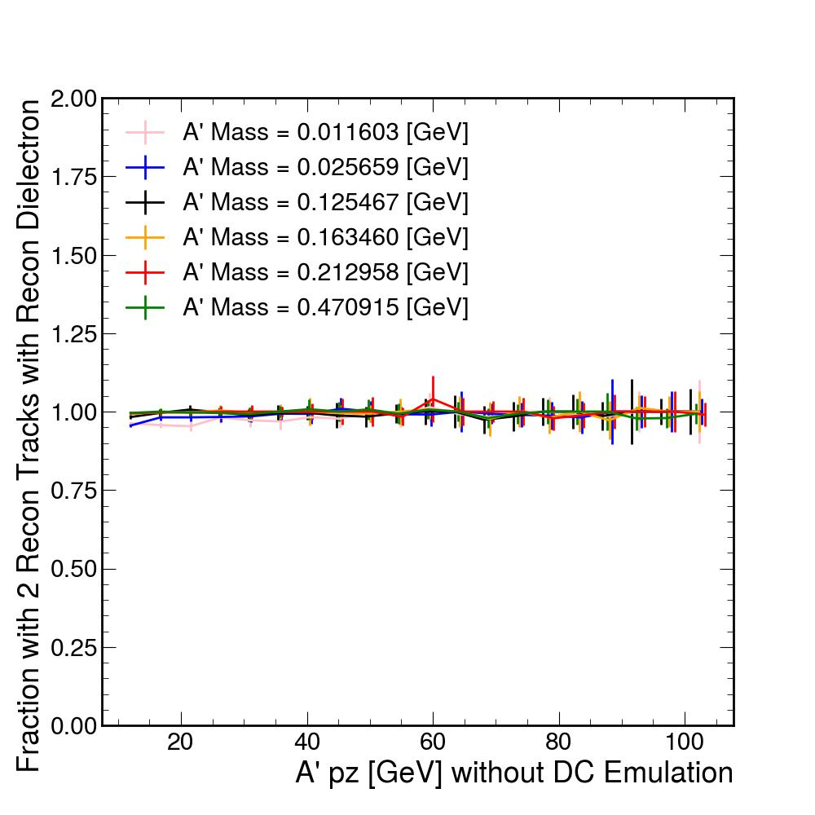
Fraction with 2 Recon. Tracks with Recon. Dielectron

Slide 18
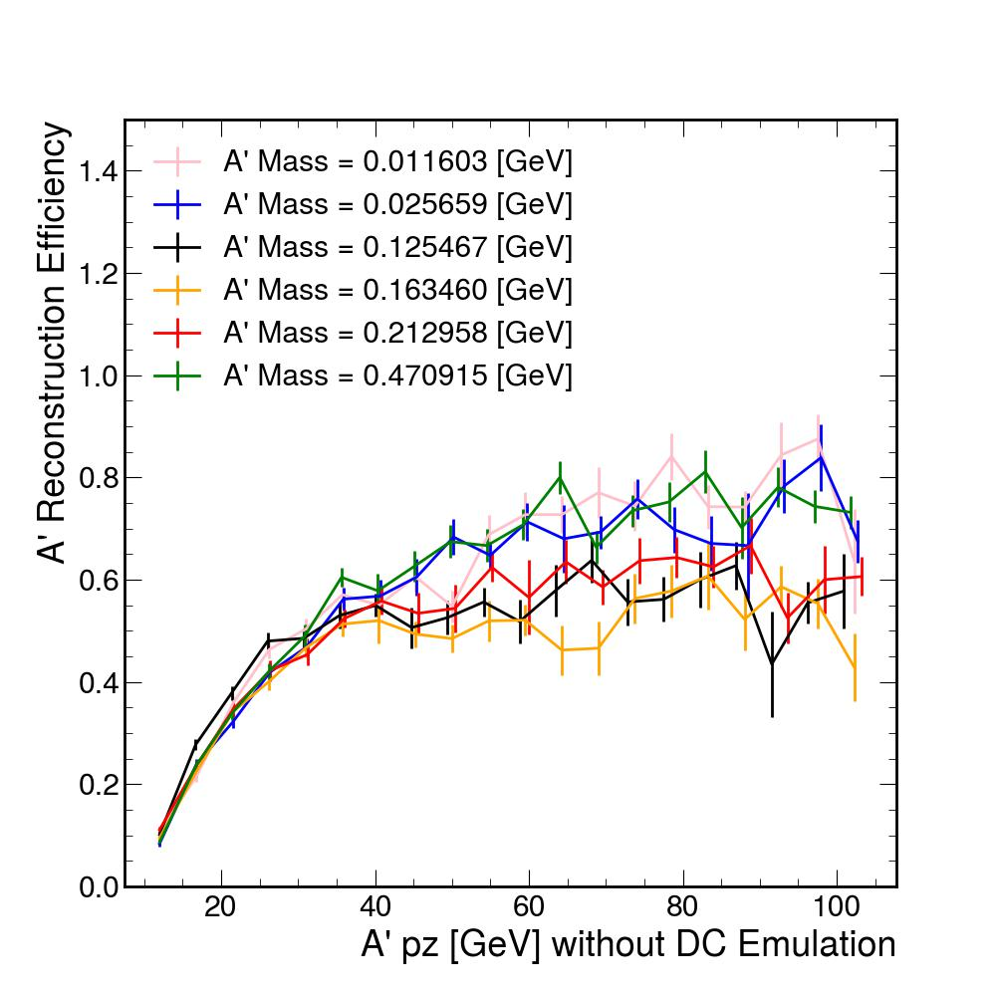
A’ Reconstruction Efficiency

Slide 19
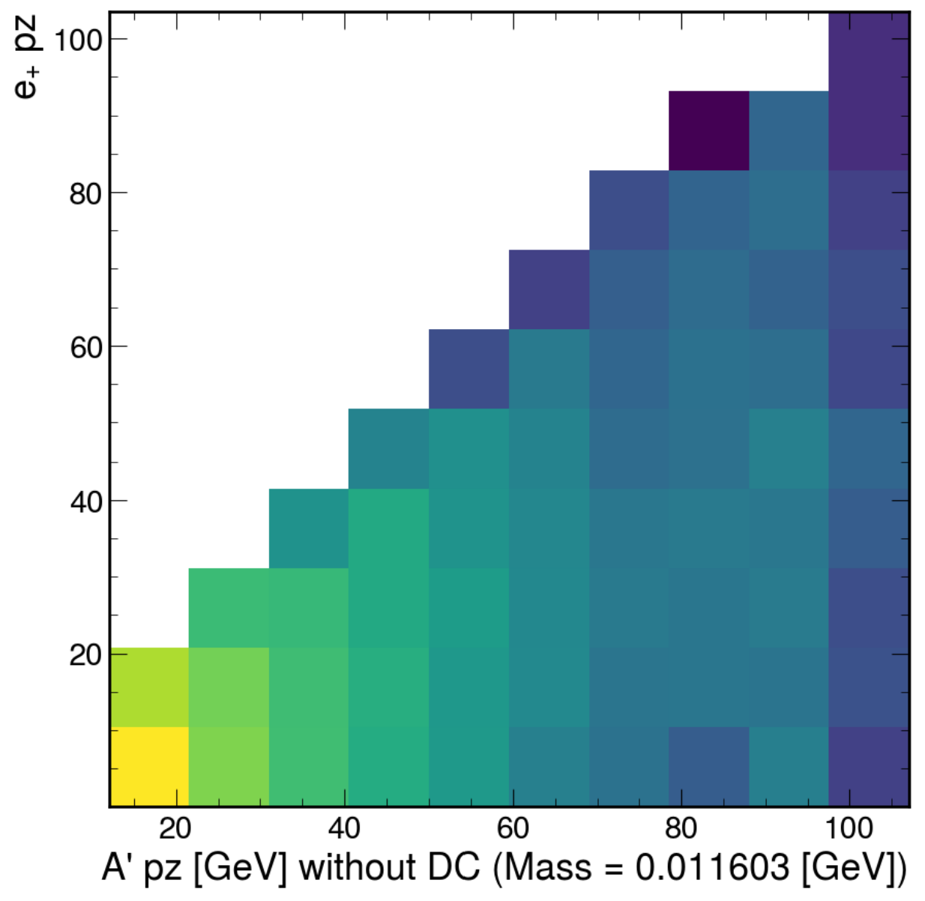
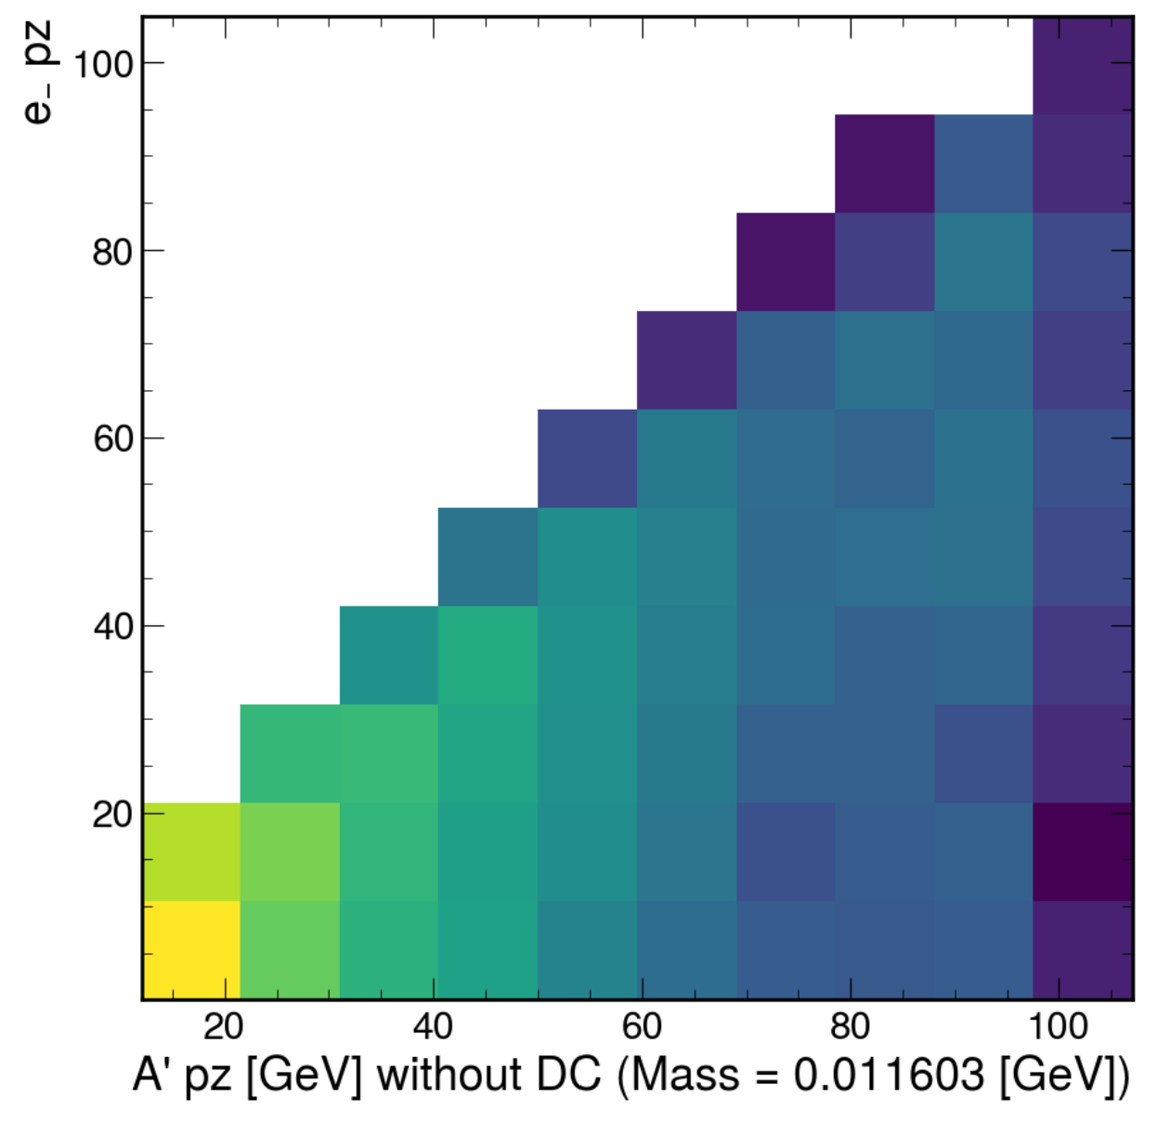
e+/e- pz (A’ mass = 0.011603 GeV)

Slide 20
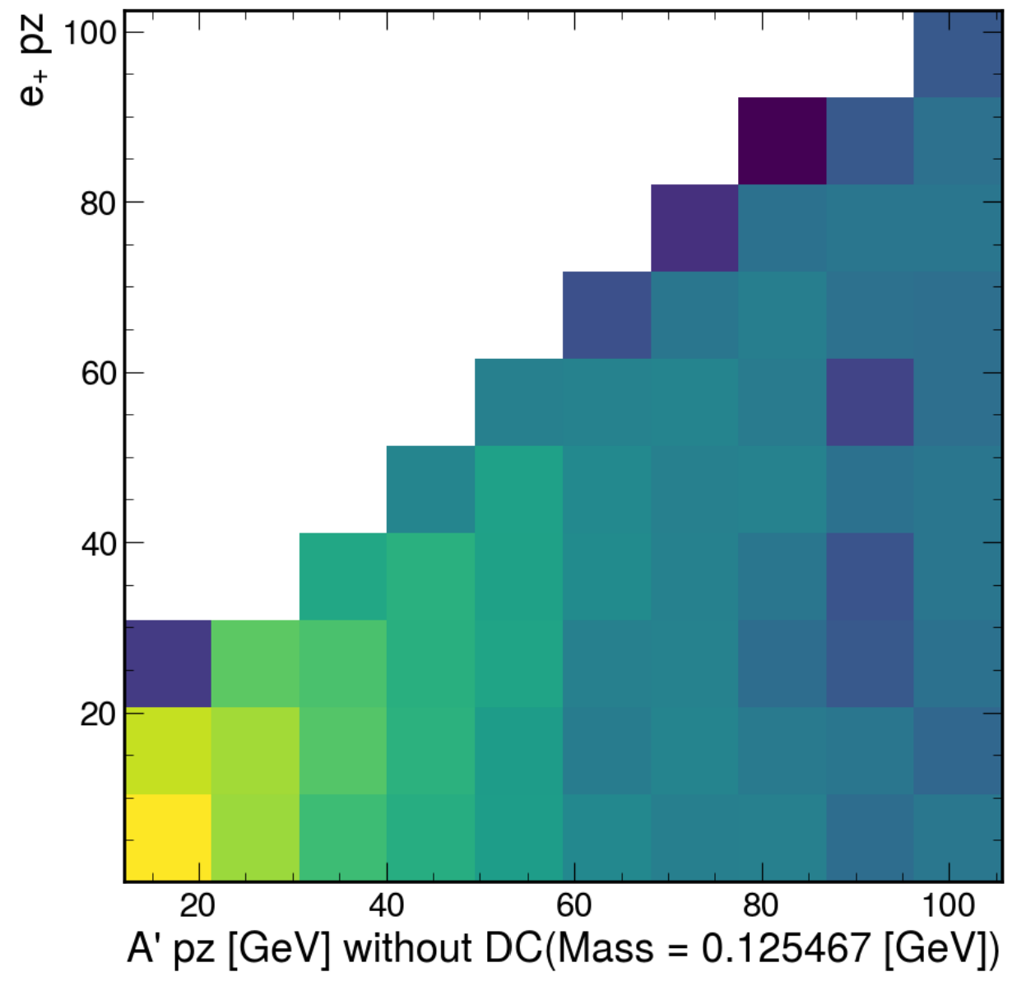
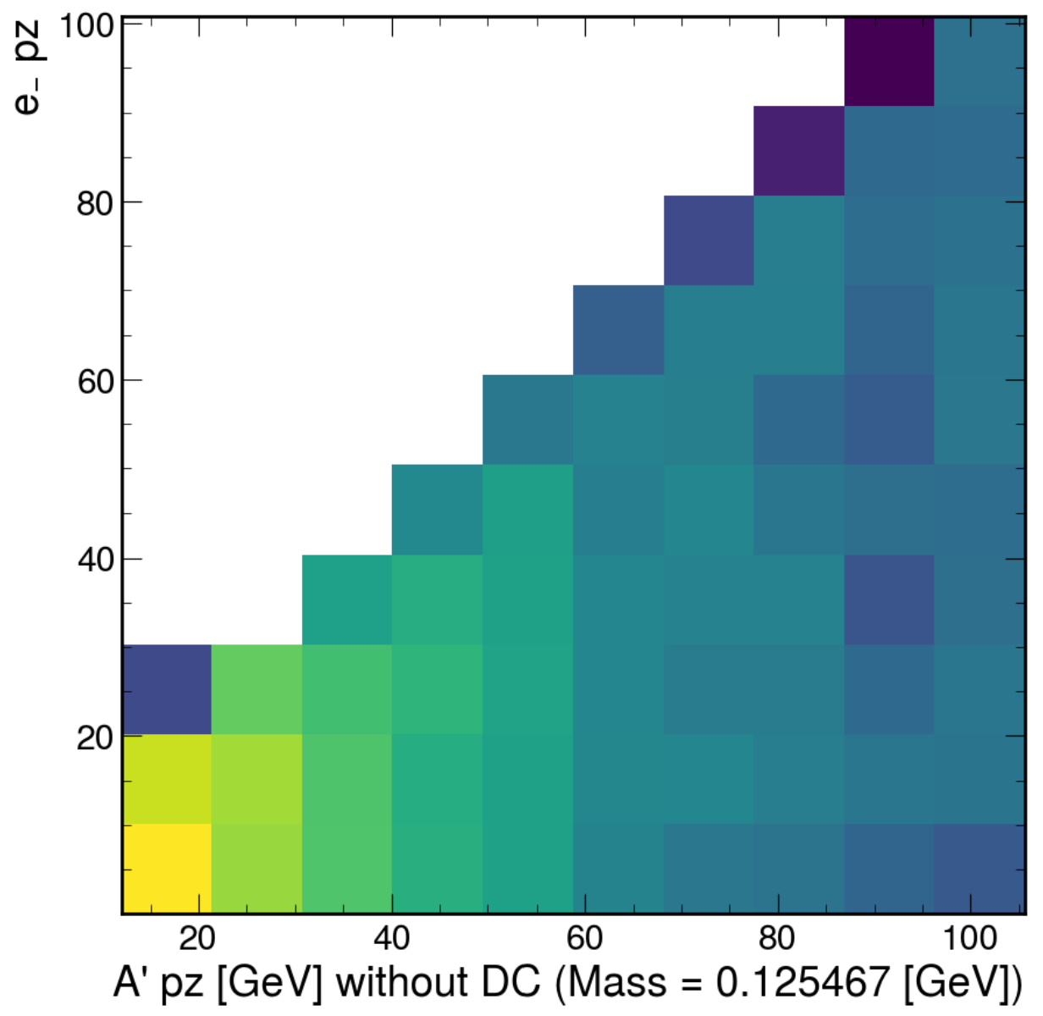
e+/e- pz (A’ mass = 0.125467 GeV)

Slide 21
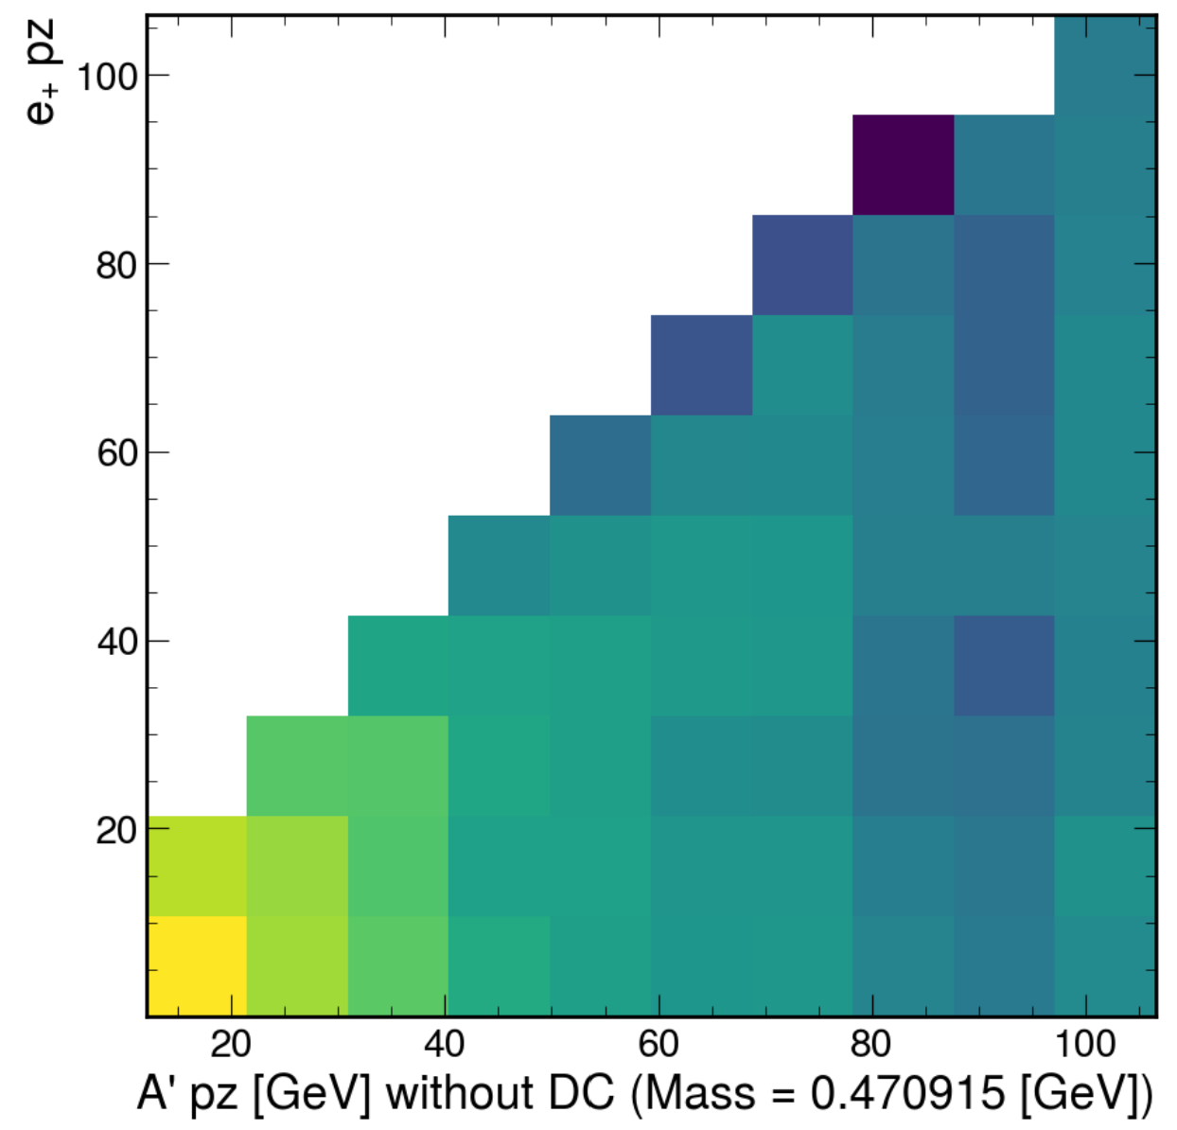
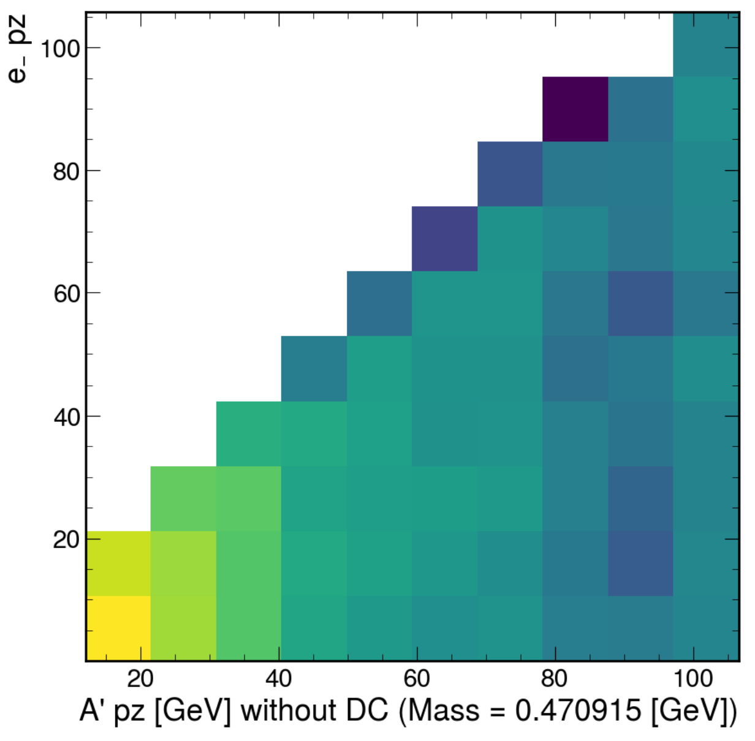
e+/e- pz (A’ mass = 0.470915 GeV)

Slide 22
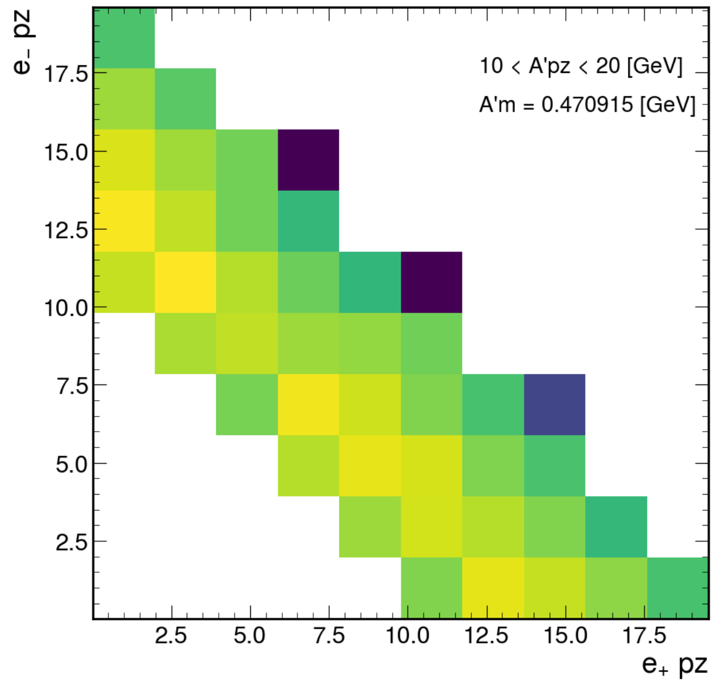
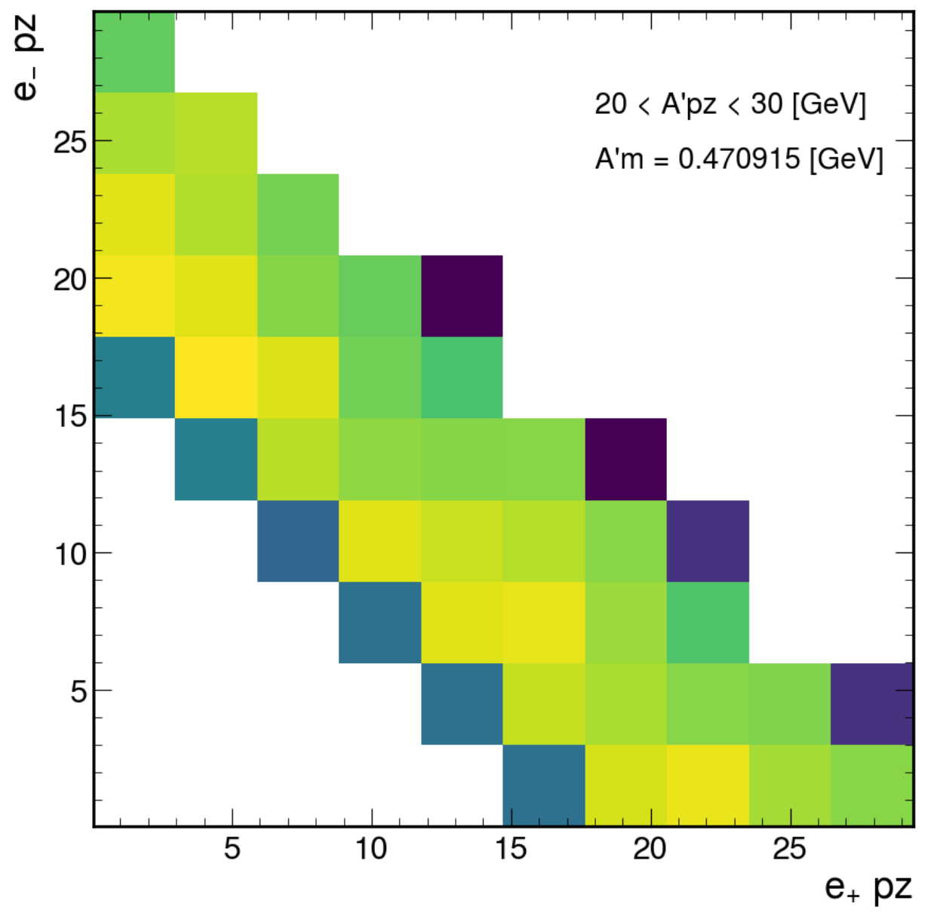
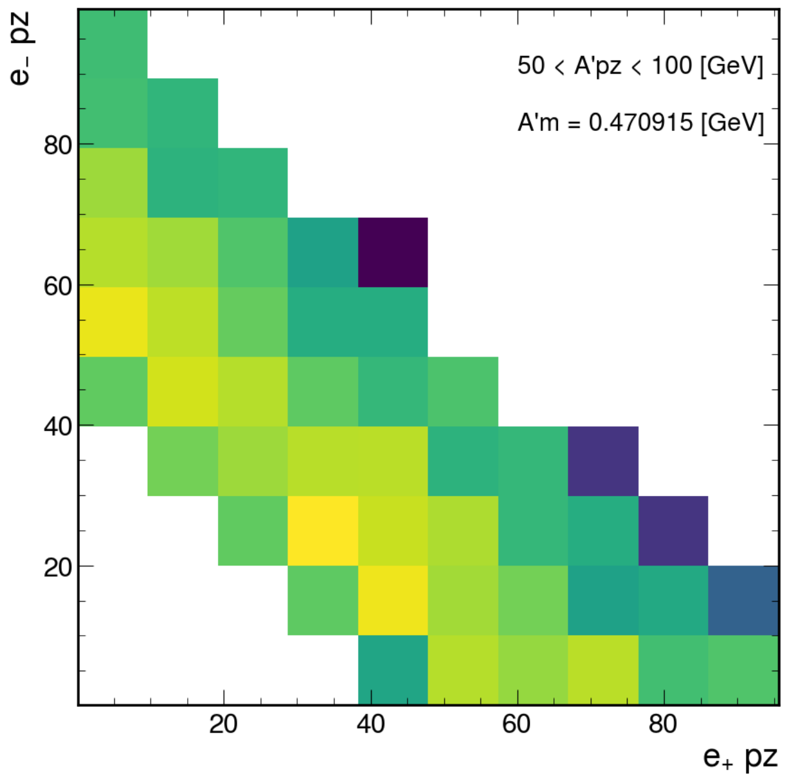
e+ versus e- pz, A’ mass = 0.470915 GeV

Slide 23
A’ μμ
200-600 cm

Slide 24
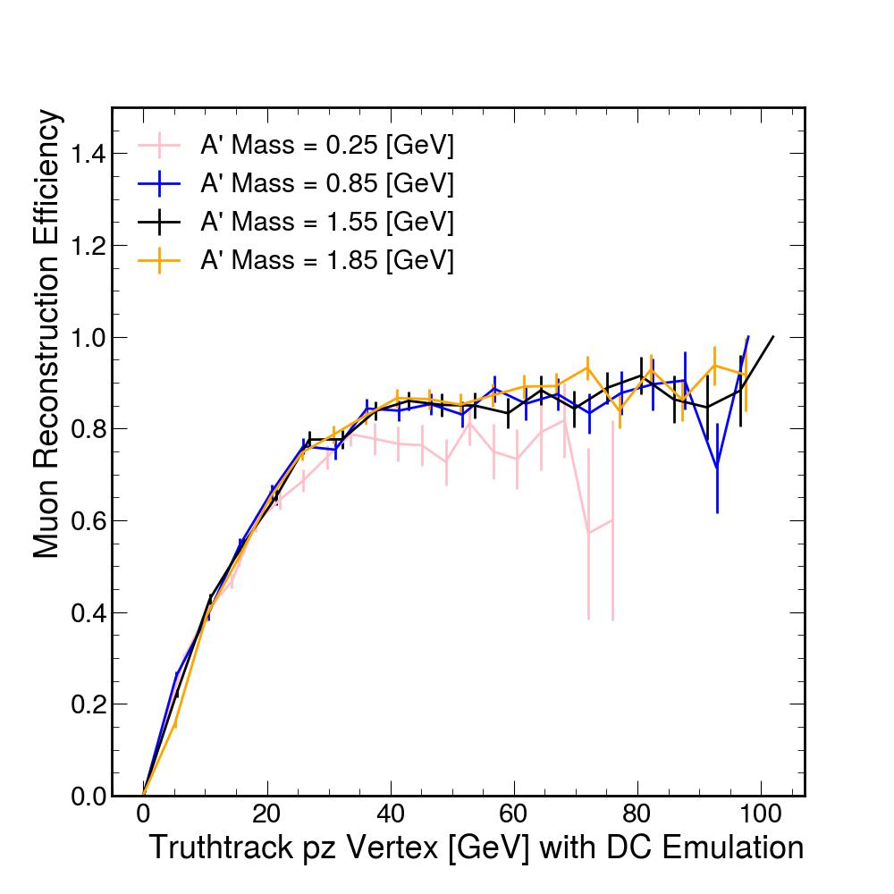
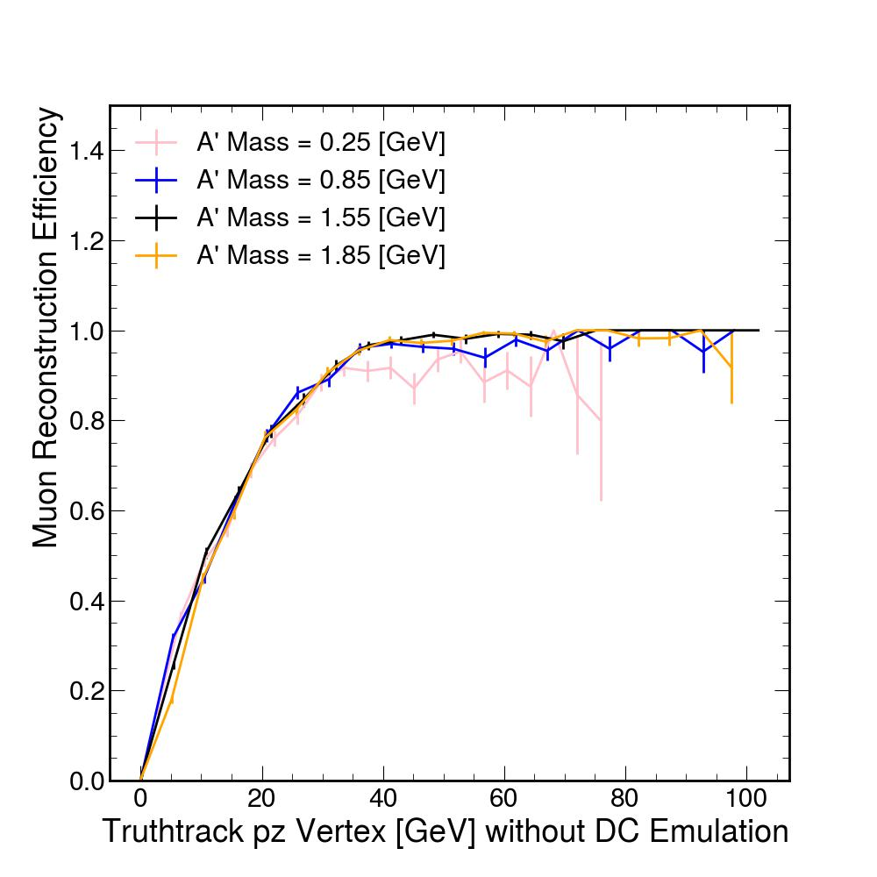
Muon Reconstruction Efficiency

Slide 25
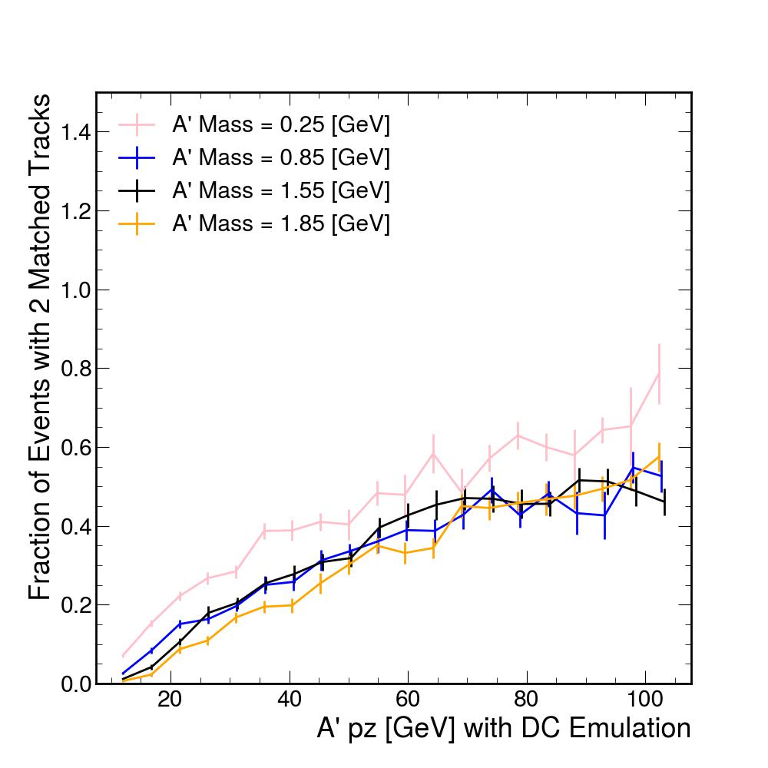
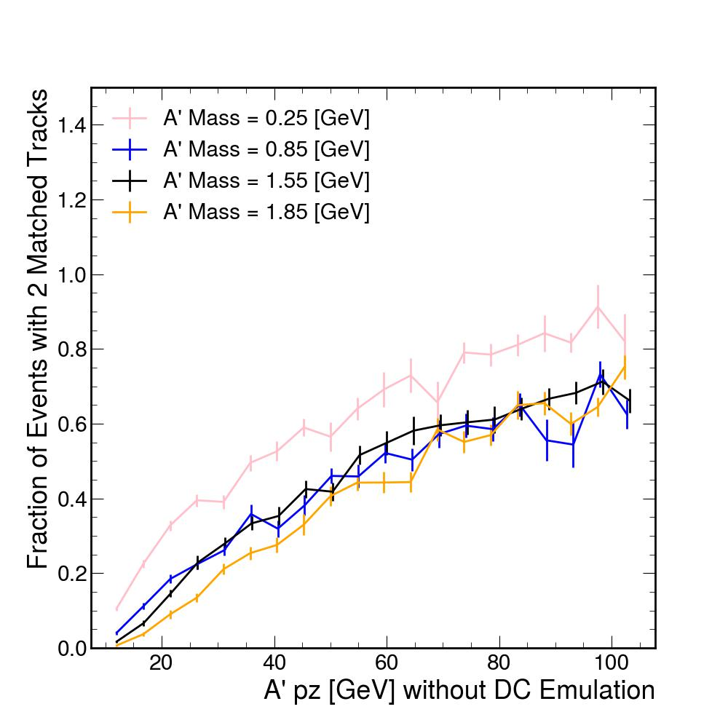
Fraction of Events with 2 Matched Tracks

Slide 26
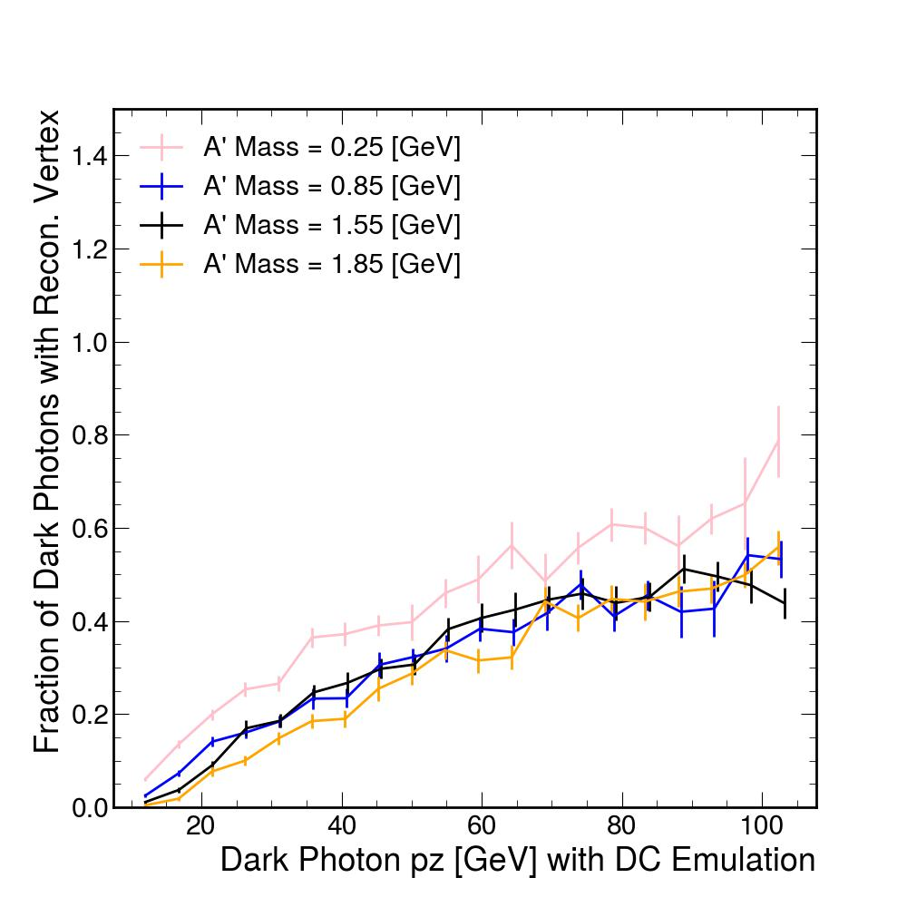
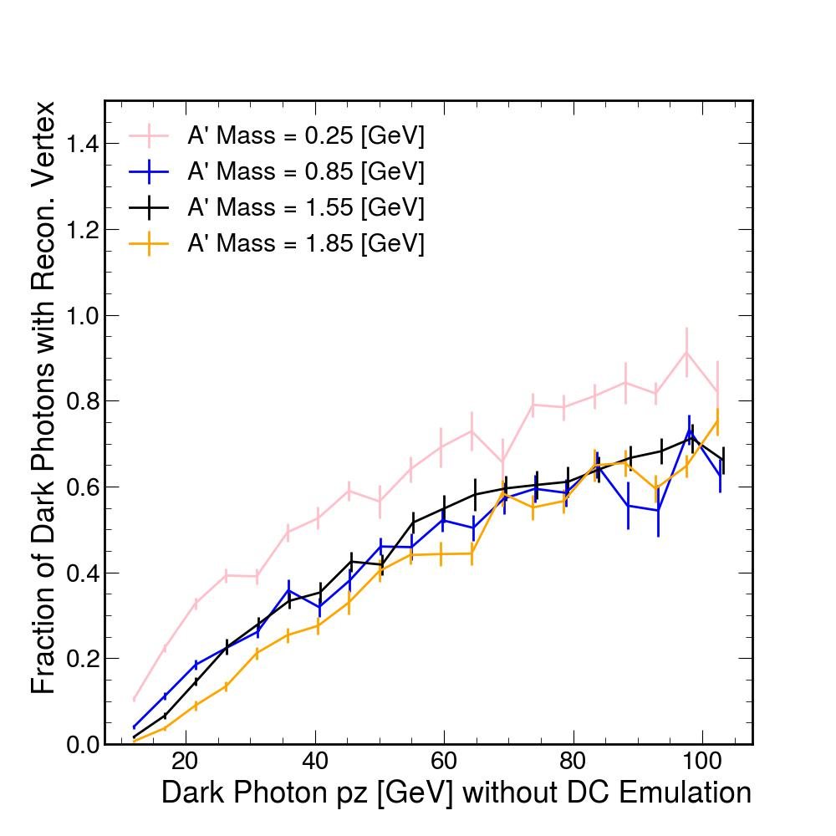
Fraction of Dark Photons with Reconstructed Vertex

Slide 27
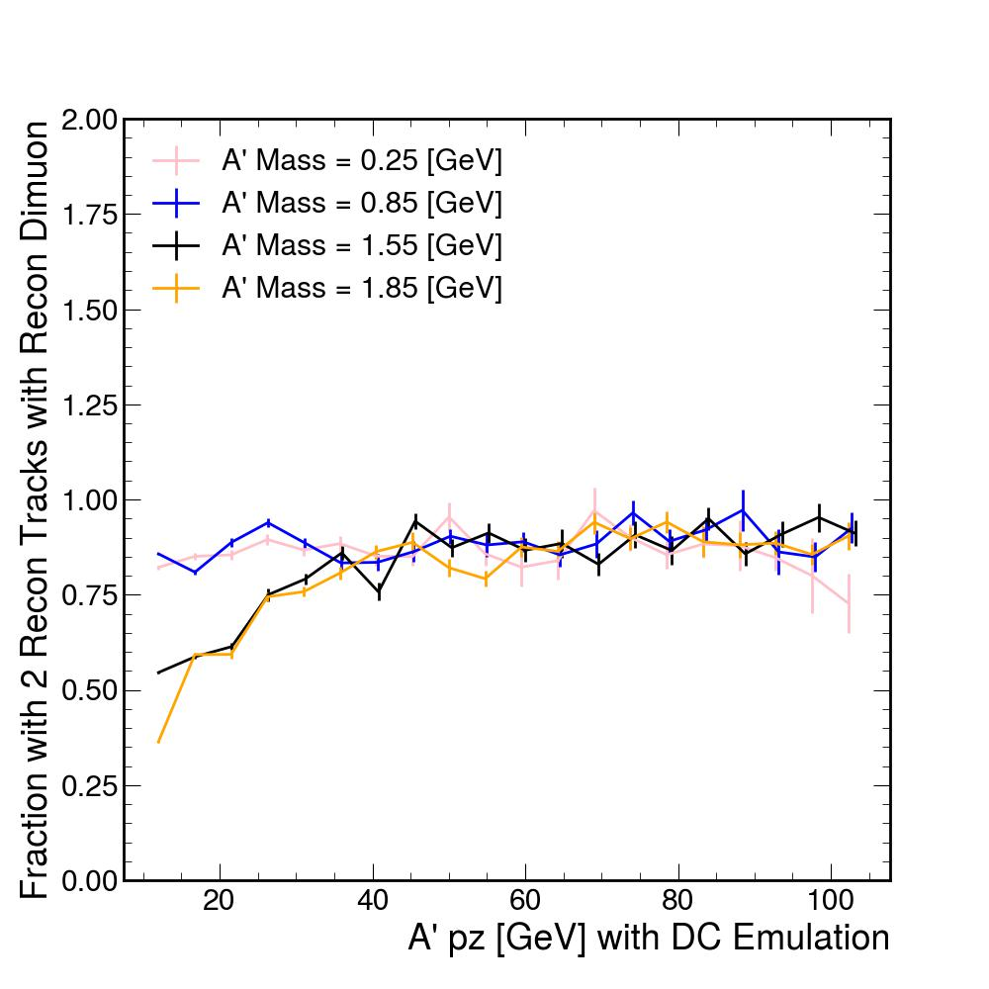
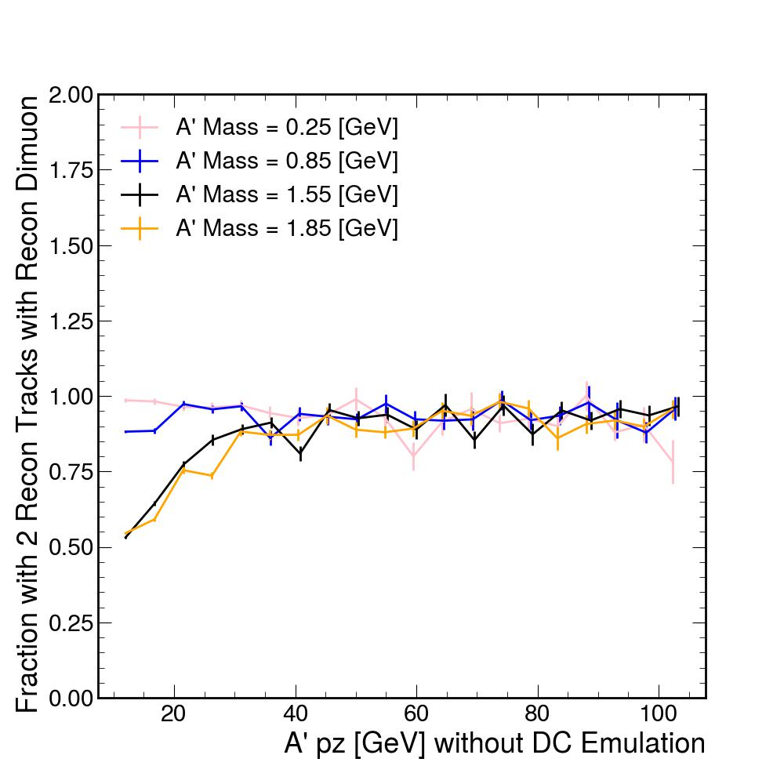
Fraction with 2 Recon. Tracks with Recon. Dielectron

Slide 28
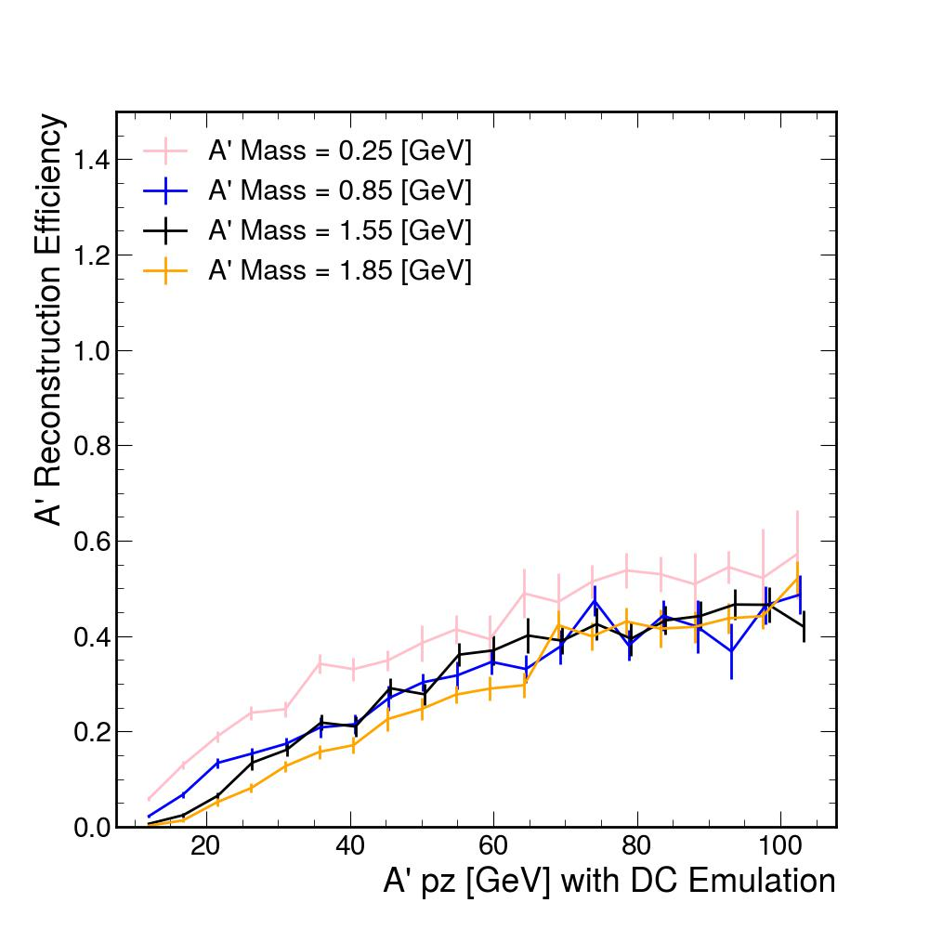
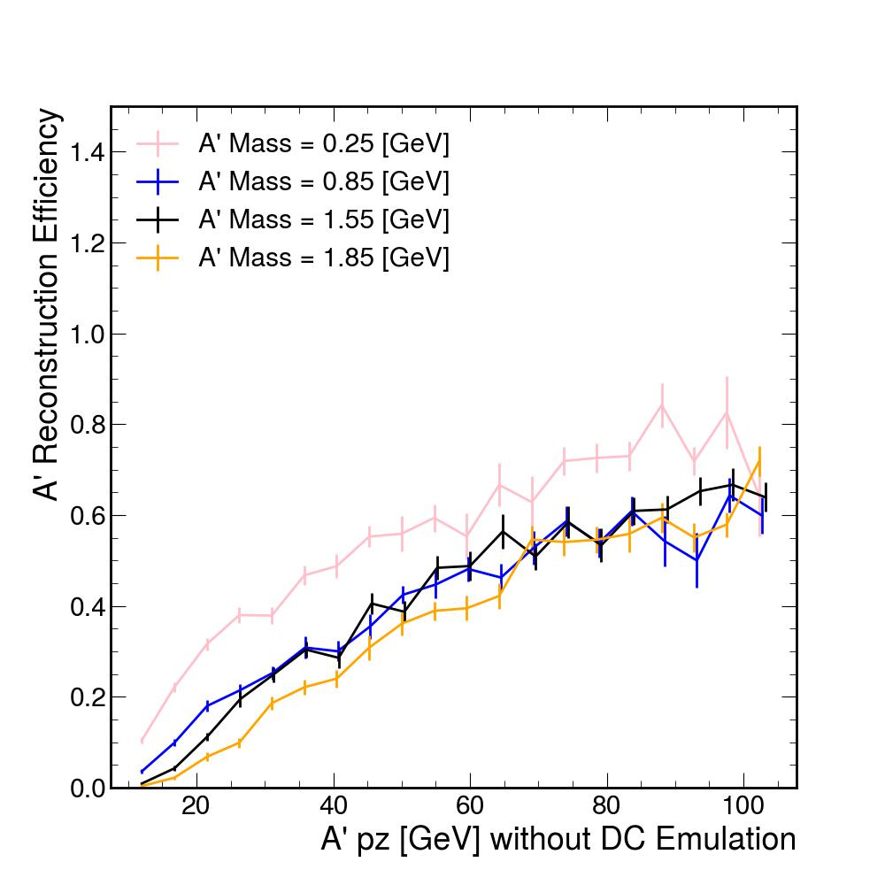
A’ Reconstruction Efficiency

Slide 29
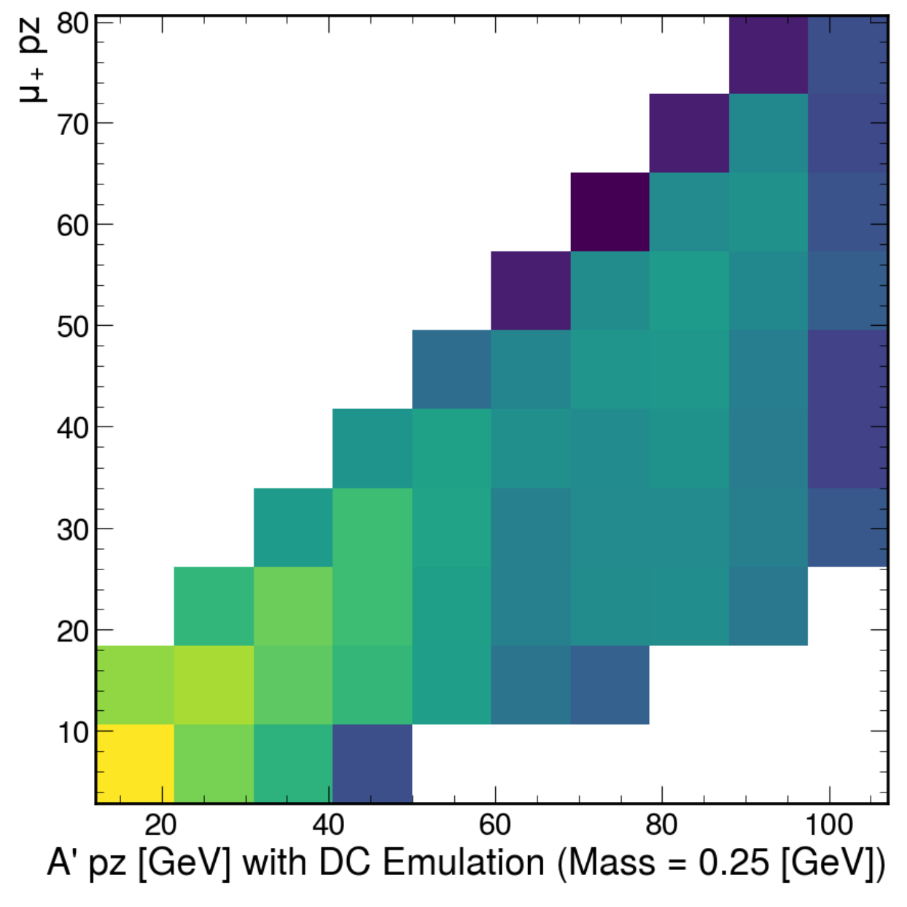
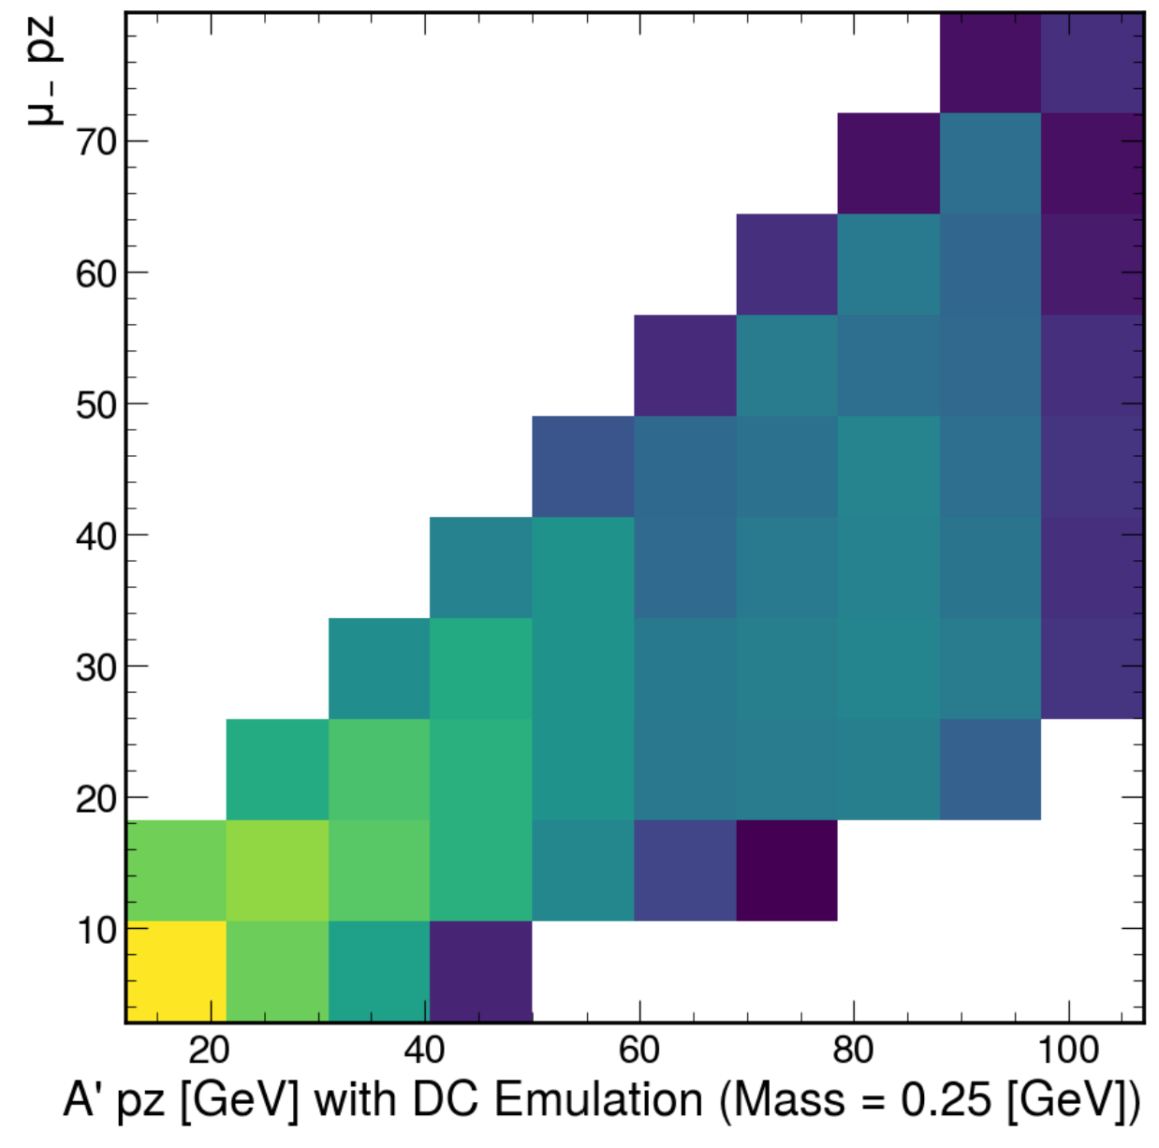
μ+/μ- pz (A’ mass = 0.25 GeV)

Slide 30


μ+/μ- pz (A’ mass = 0.85 GeV)

Slide 31


μ+/μ- pz (A’ mass = 1.85 GeV)

Slide 32
μ+/μ- pz (A’ mass = 3.05 GeV)

Slide 33



μ+ versus μ- pz, A’ mass = 1.85 GeV

Slide 34
A’ μμ
200-300 cm

Slide 35
A’ μμ
300-400 cm

Slide 36
A’ μμ
400-500 cm

Slide 37
A’ ee
200-600 cm

Slide 38
Electron Reconstruction Efficiency

Slide 39
Fraction of Events with 2 Matched Tracks

Slide 40
Fraction of Dark Photons with Reconstructed Vertex

Slide 41
Fraction with 2 Recon. Tracks with Recon. Dielectron

Slide 42
A’ Reconstruction Efficiency

Slide 43
e+/e- pz (A’ mass = 0.125467 GeV)

Slide 44
e+/e- pz (A’ mass = 0.470915 GeV)

Slide 45
e+/e- pz (A’ mass = 2.302710 GeV)

Slide 46
e+ versus e- pz, A’ mass = 0.470915 GeV

